Slide 1
Introduction to R & Statistical Computing
Dr. Chris Bird
Texas A&M University – Corpus Christi
Based Upon “Computing Skills For Biologists”

Slide 2
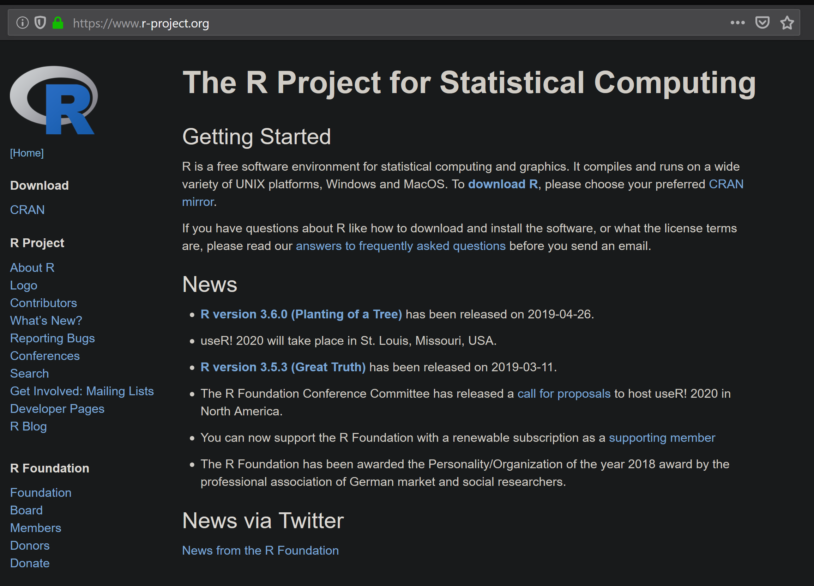
R is a statistical computing language
Free
Open source
Popular among biologists
Almost any analysis is available for free
Easy to use
Flexible
Command line interface
Linux, Win, Mac

Slide 3
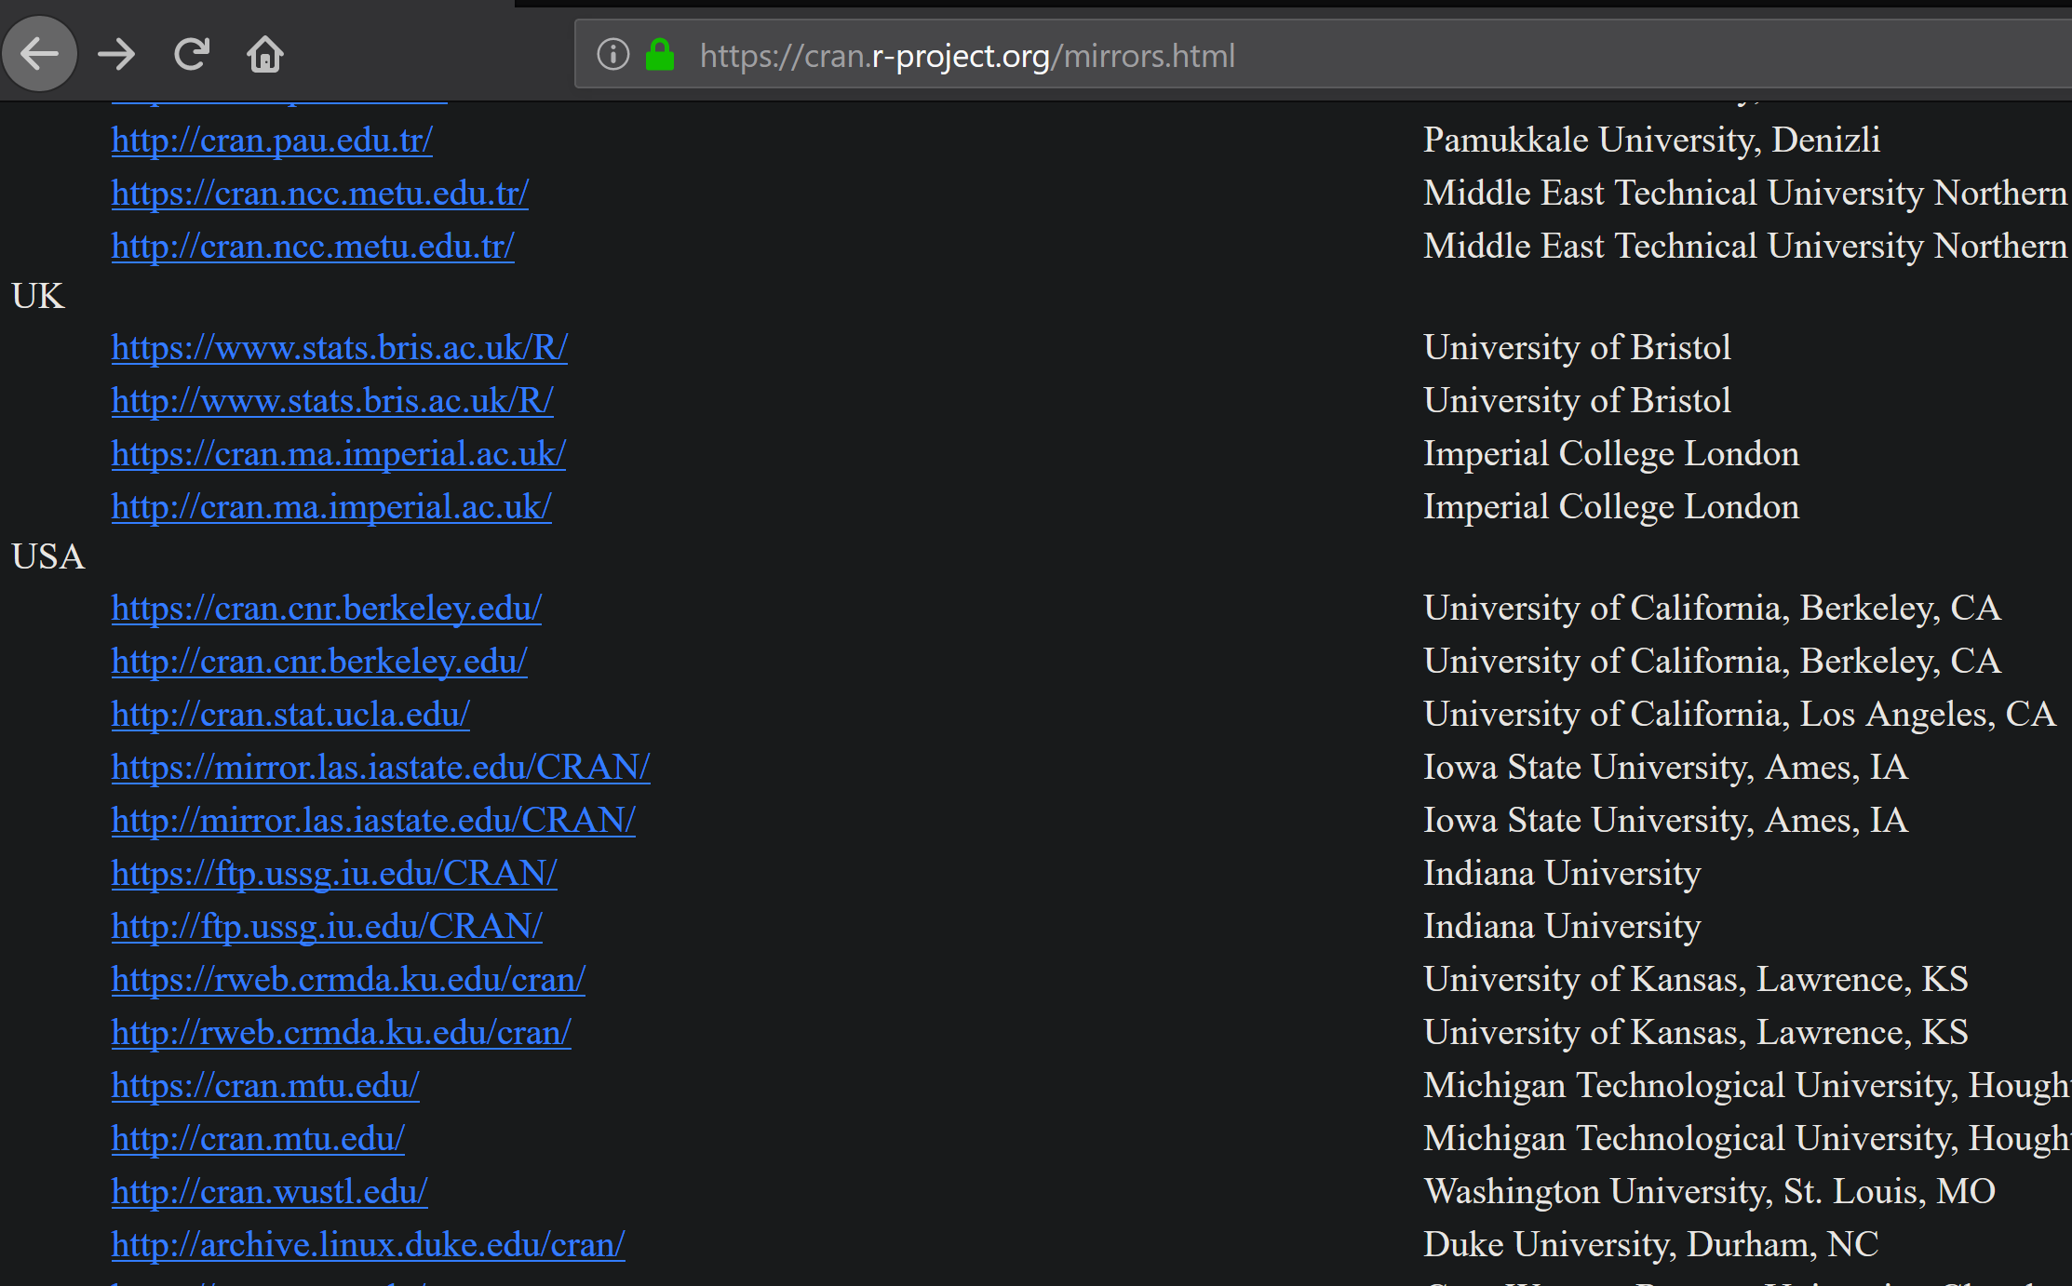
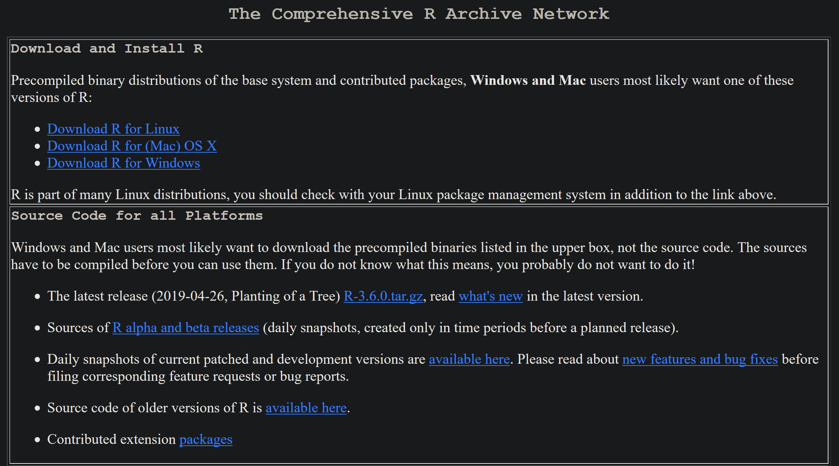
Installing R is Easy
Follow the Download R link
Choose a mirror
Select appropriate OS
Linux command line shortcut:
sudo apt-get install r-base

Slide 4
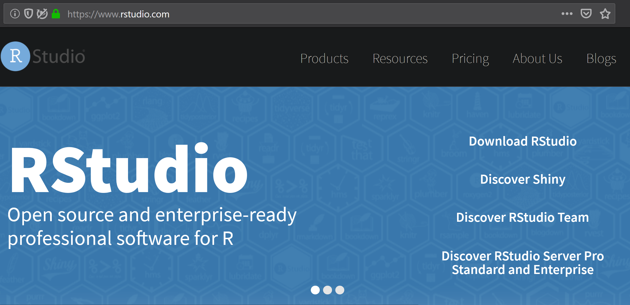
R Studio is a GUI for Developing R Code

Slide 5
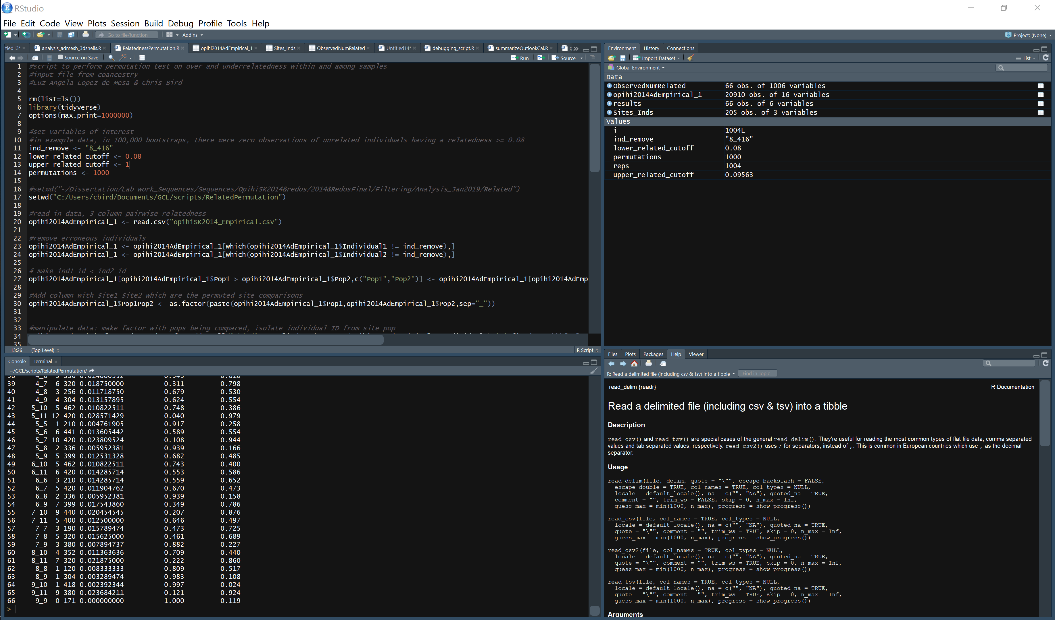
Code Editor
Data Containers & Variables
Command Line
Help

Slide 6
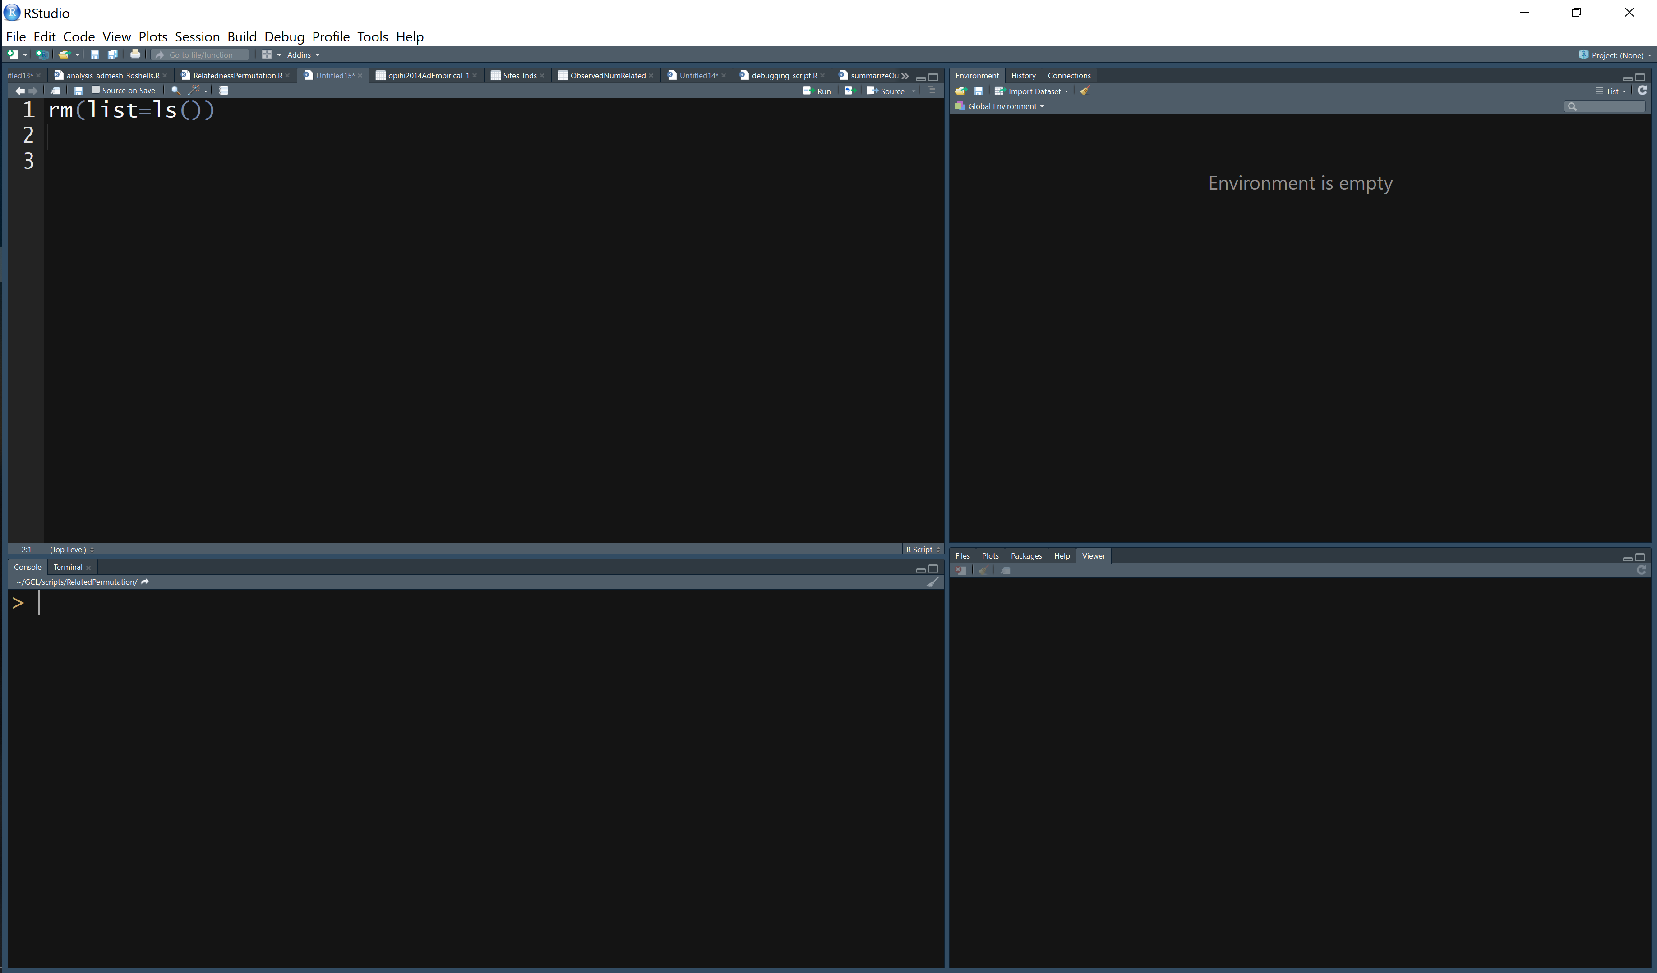
Using R Studio to do Arithmetic
Type 3^3 here and press Ctrl+Enter
Type 2*2 here and press Enter

Slide 7
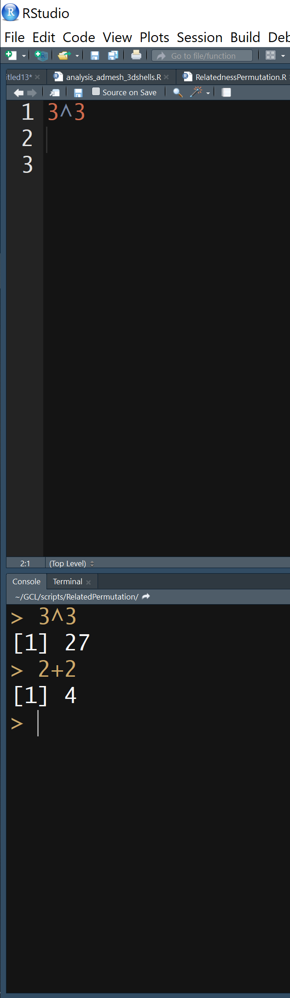
Basic use of R Studio
Editor
Place to craft your code
Run highlighted code: Ctrl + Enter
Run code on line: Ctrl + Enter
Run code on all lines: Ctrl + Shift +S
Command line
Native R interface
Without R Studio, this is how you would interface with R
Run code: Enter
Editor
Command line

Slide 8
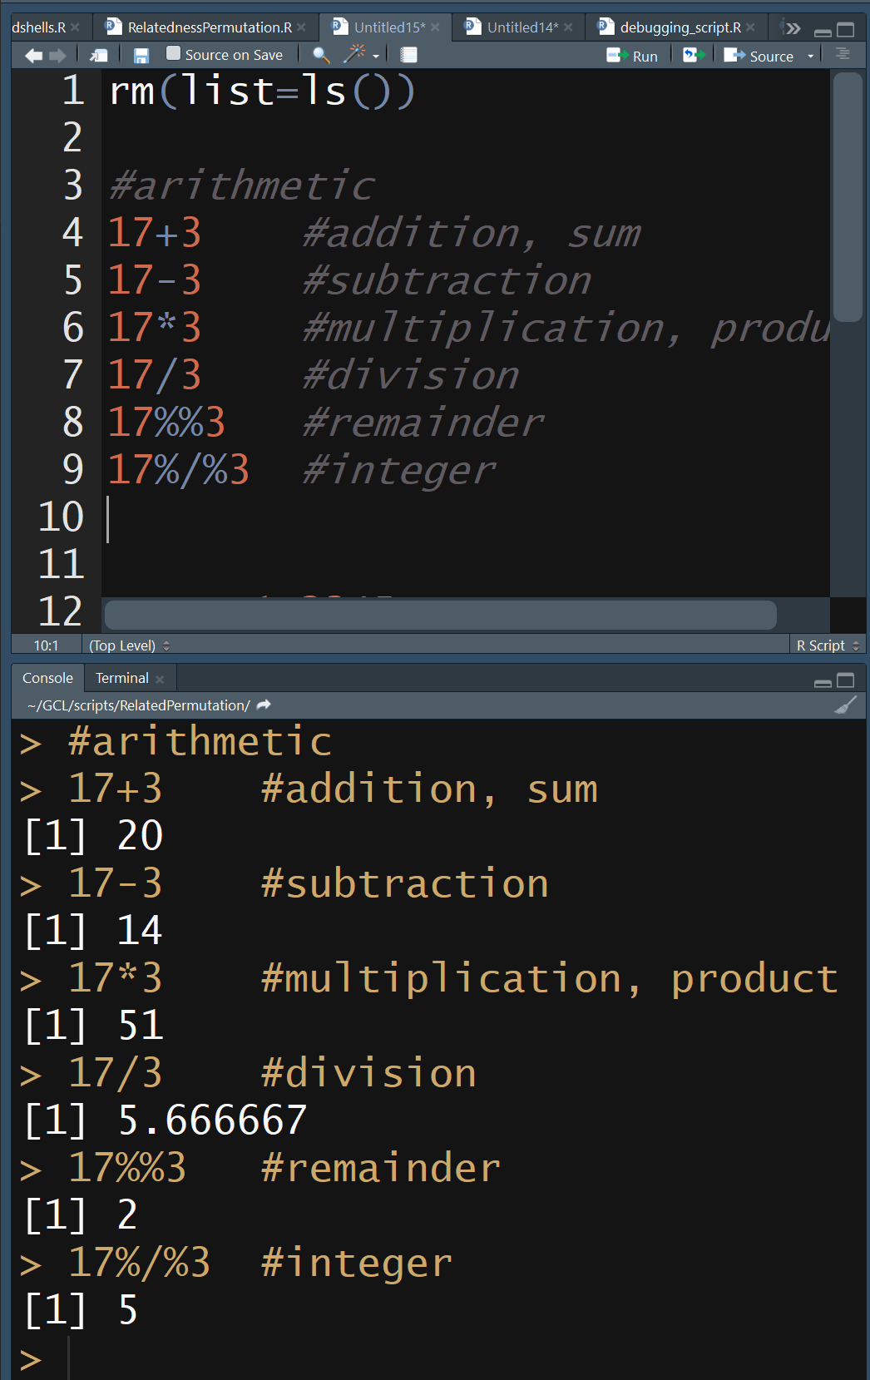
Arithmetic in R
+ Addition
- Subtraction
* Multiplication
/ Division
^ Exponentiation
%% Modulo (remainder from division)
%/% Integer Division

Slide 9
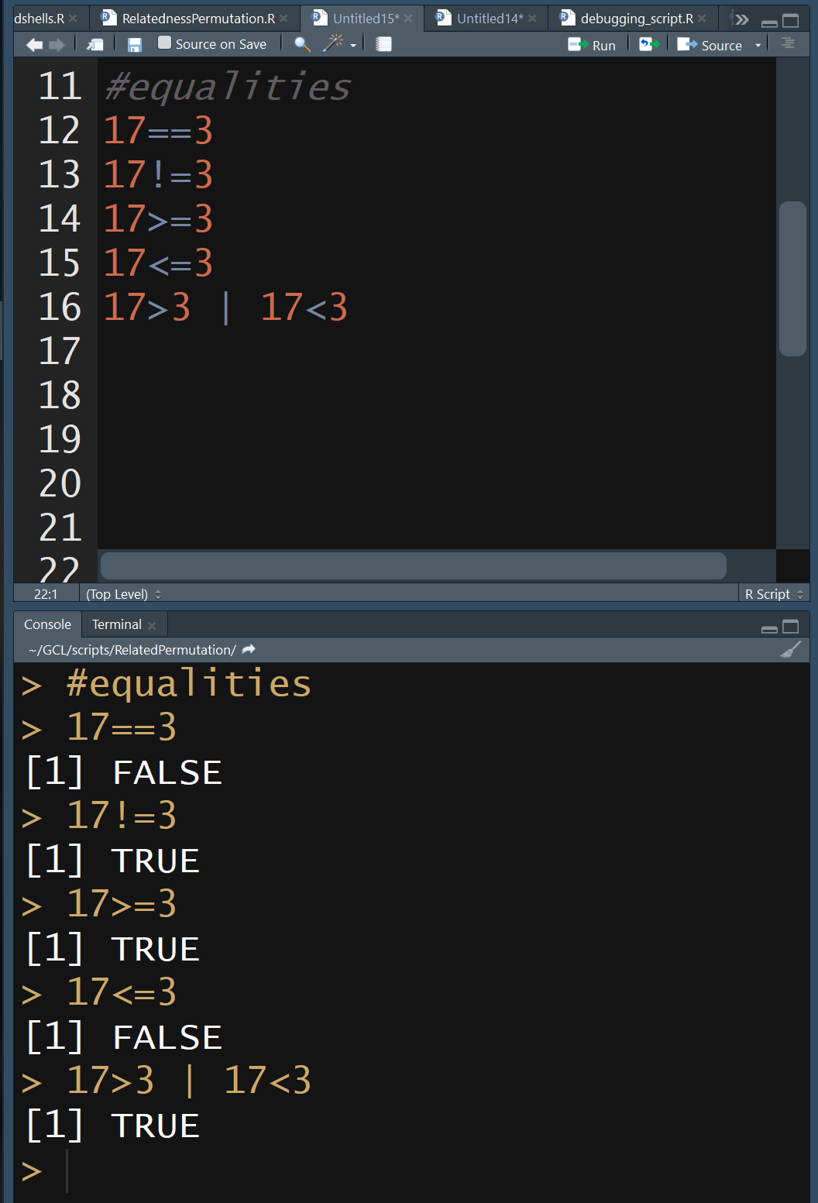
Equalities & Logic in R
== Equal to
!= Not equal to
> Greater than
< Less than
>= Greater than or equal
<= Less than or equal
& And
| Or
! Not
CTRL+L to clear the command line

Slide 10
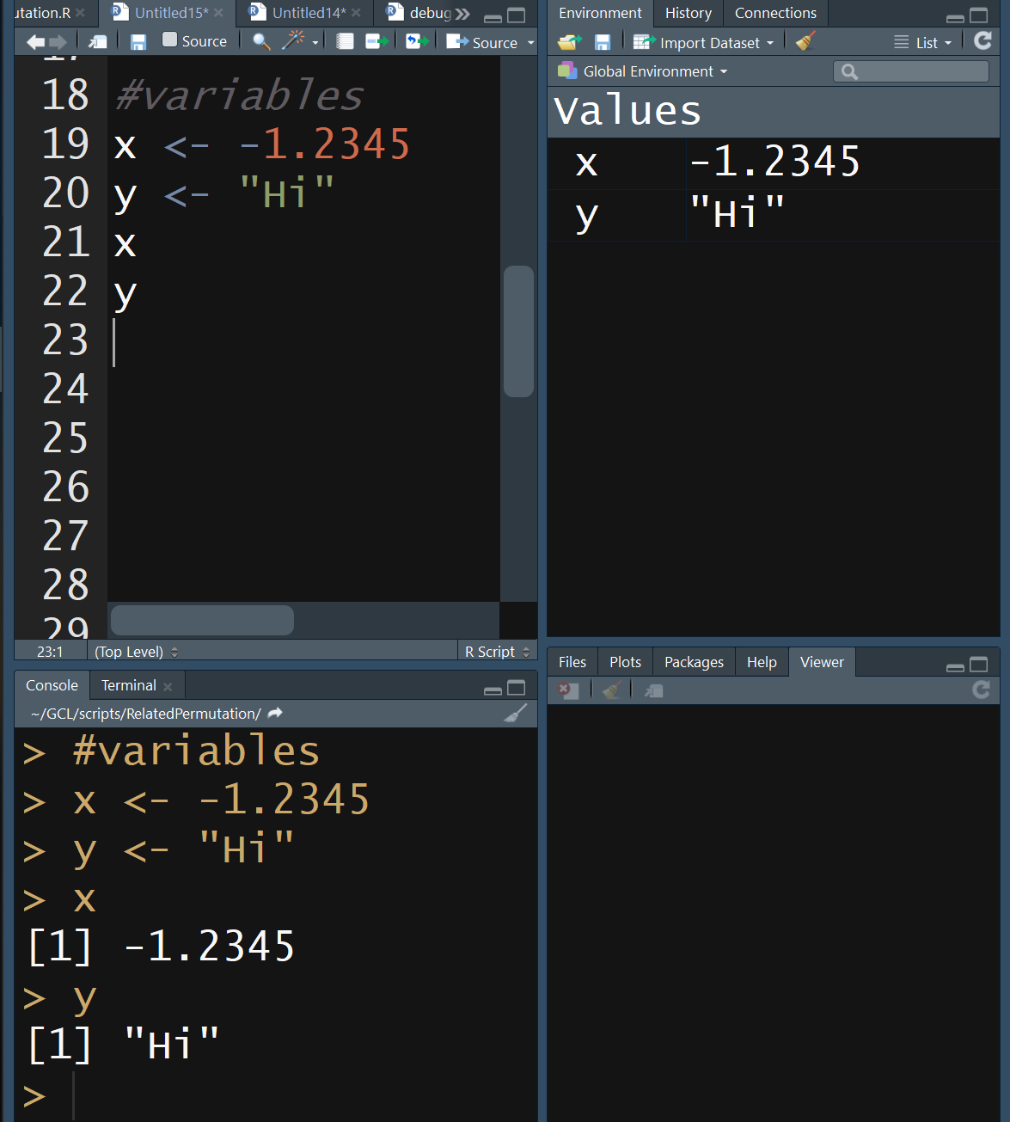
R Variables
Variables hold data
Any alpha-numeric
Values are numbers or strings
Values can be assigned to variables using <-
Clear all variables: rm(list=ls())

Slide 11
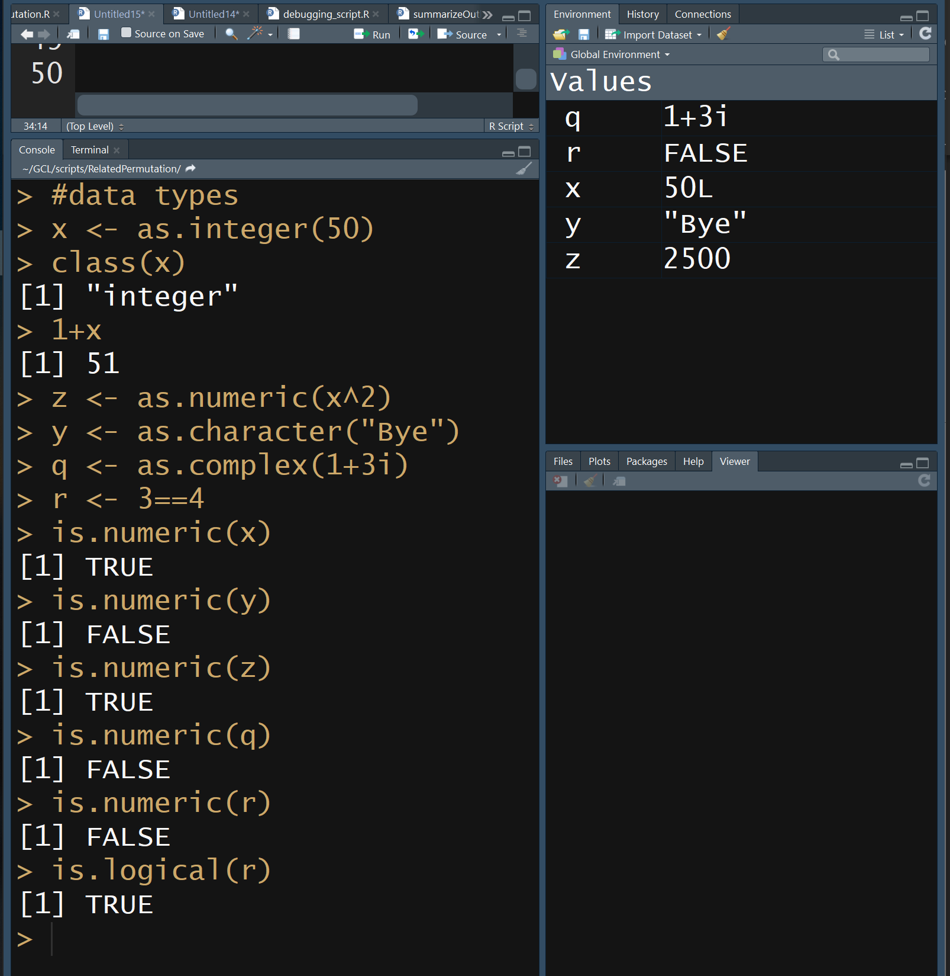
R Data Types
integer Whole Numbers
numeric Real Numbers
complex Complex Numbers
logical TRUE or FALSE
character String
Specify data type using as.type(variable)
Query data type use is.type(variable)

Slide 12
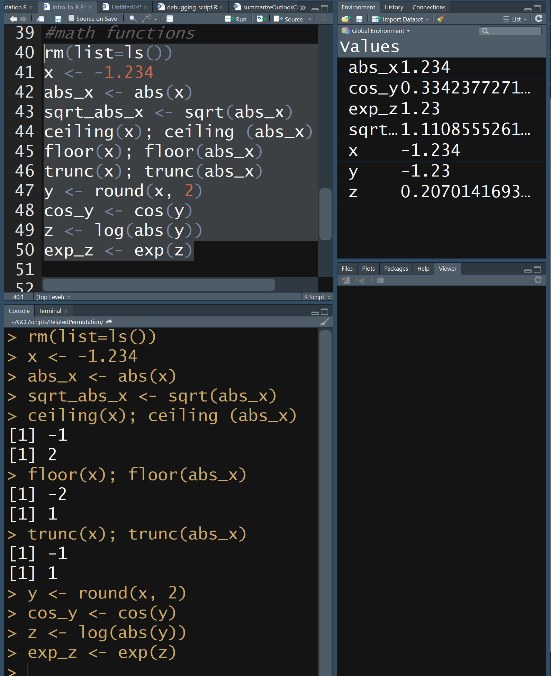
Mathematical Functions in R
abs(x) absolute value
sqrt(x) square root
ceiling(x) round up
floor(x) round down
trunc(x) remove decimals
round(x,digits=n) round x to n digits
cos(x), sin(x), tan(x), etc trig
log(x) natural log
exp(x) e^{x}
log10(x) base 10 log

Slide 13
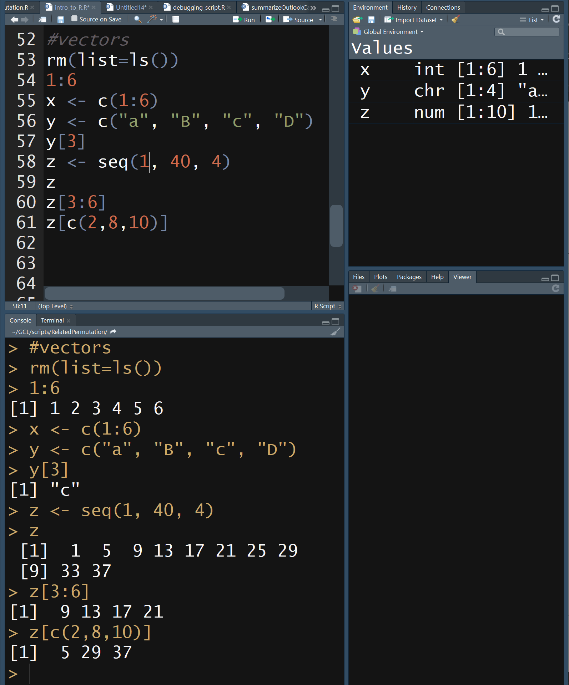
R Data Structures: Vectors
Data structures store your data
Simplest data structure is a single element
A vector is a collection of elements
1, 2, 3, 4, 5, 6
Vectors can be specified using c() or seq() or rep()
Particular values in the vector can be specified by their index [index_num]
Use the Help to learn how to use the command, rep()

Slide 14
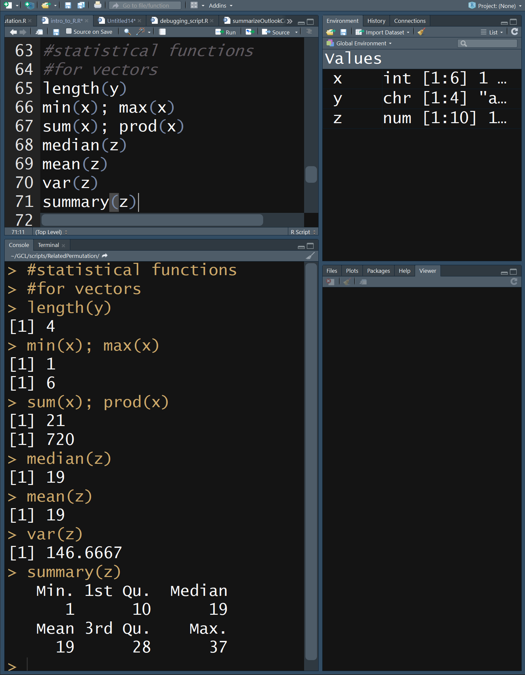
R Statistical Functions for Vectors
length(x) # elements
min(x) minimum
max(x) maximum
sum(x) sum, +
prod(x) product, *
median(x) central value
mean(x) average
summary(x)

Slide 15
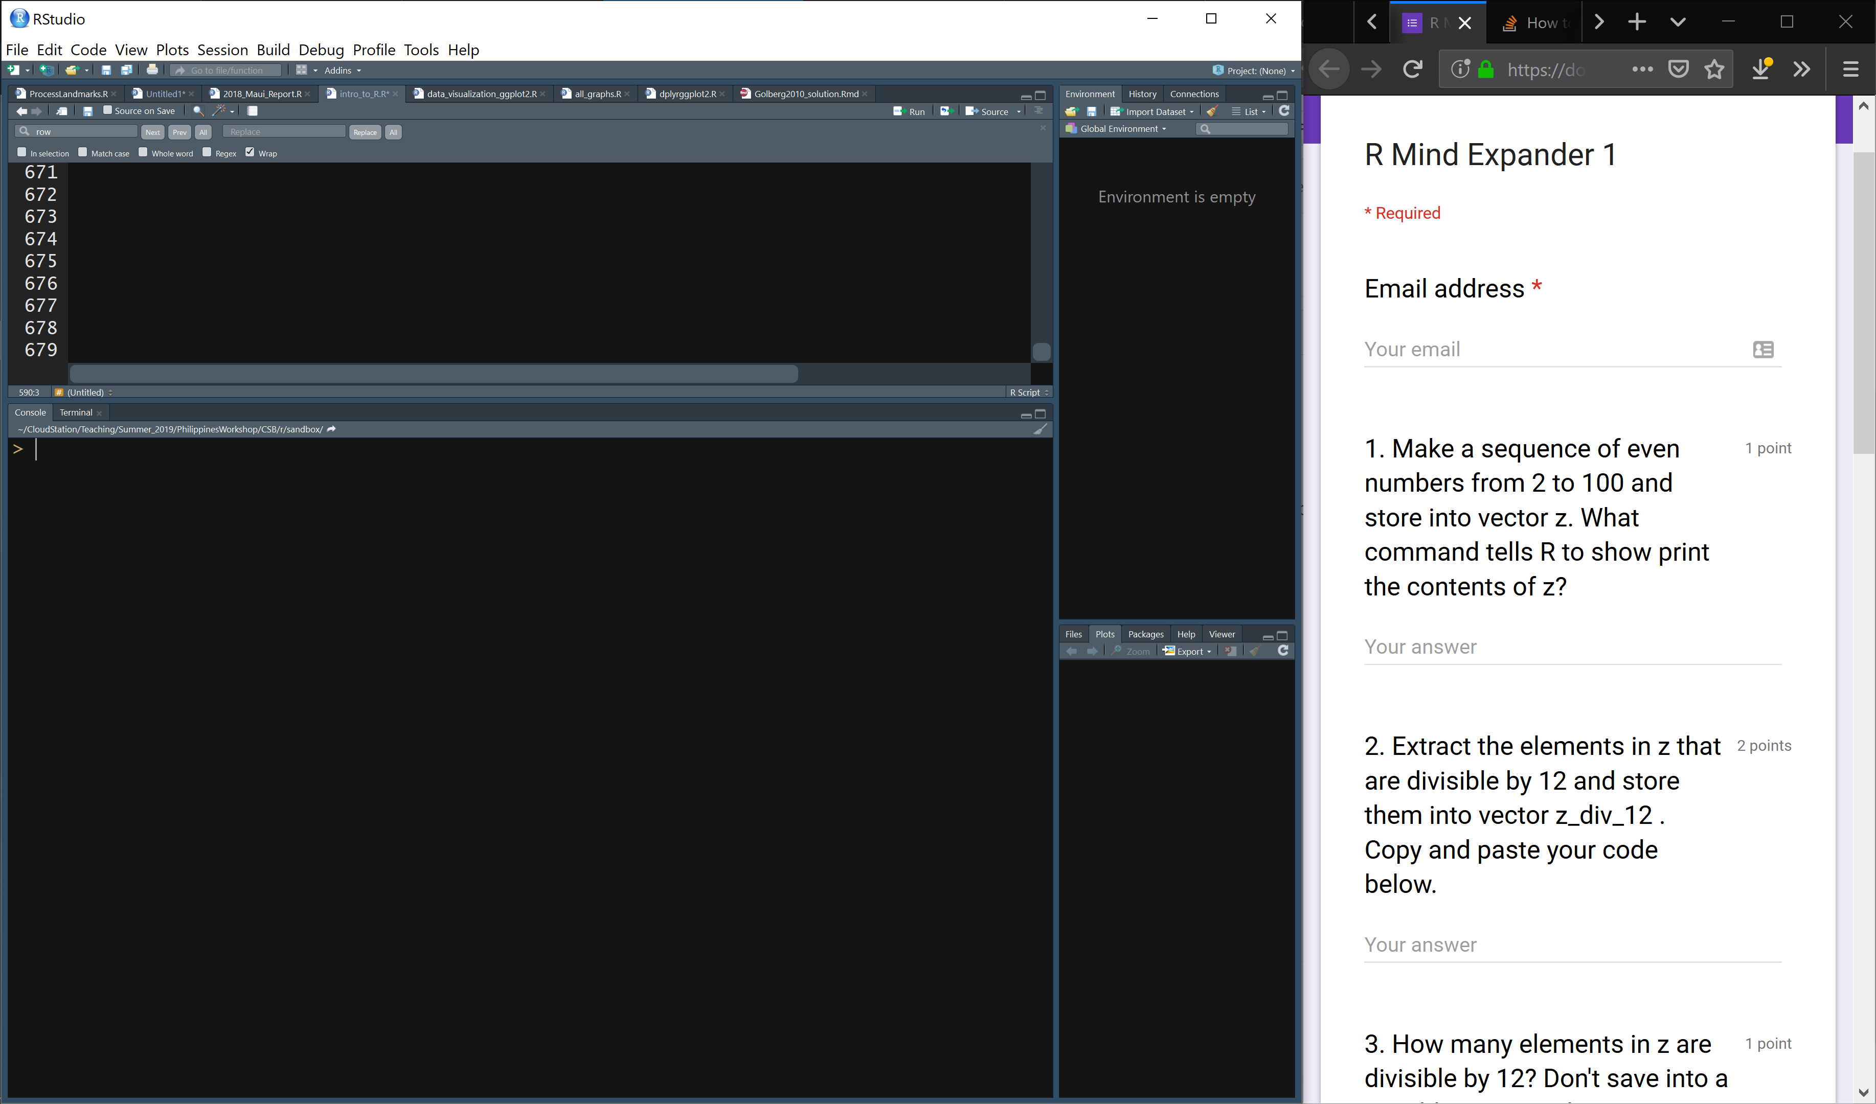
Link to Mind Expander 1 through github
Work independently or in groups to answer the questions

Slide 16
Overview of R Data Structures
Element a single value or string
Vector several elements of same data type
Matrix 2-dimensional table of elements of same data type
Array 3-dimensional table of elements of same data type
Data frame 2-dimensional table of elements, different data types
List several elements or data structures of any type

Slide 17
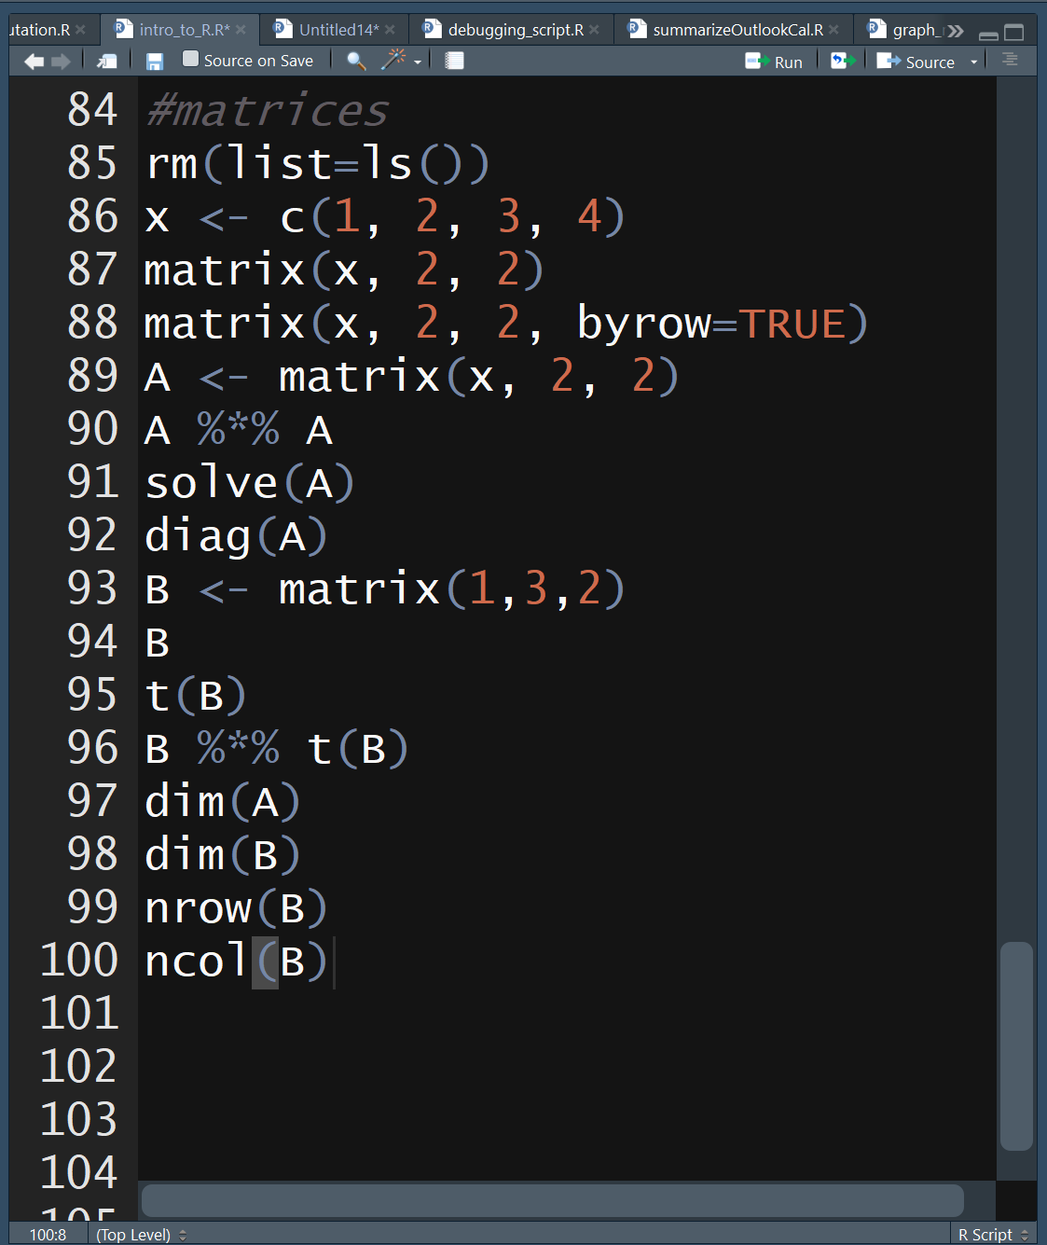
R Data Structures
Matrix
matrix(v,r,c,byrow=FALSE)
create matrix, v=vector of values, r=#rows, c=#cols, if byrow=TRUE then values are filled in by row
Matrix math
%*% matrix product
solve() matrix inverse
diag() diagonal values
t() transpose
Matrix functions
dim() dimensions, rows cols
nrow() # rows
ncol() # cols

Slide 18
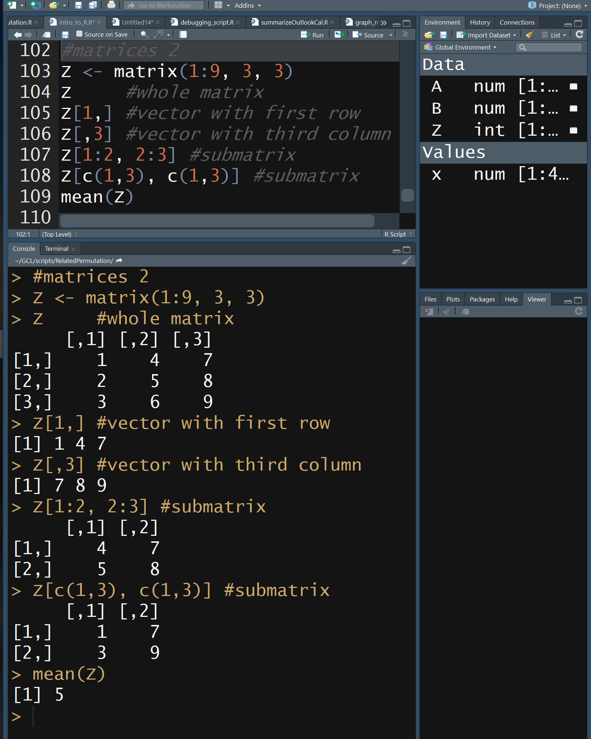
R Data Structures
Matrix
Matrix elments are indexed by row and col.
matrixName[rowNum,colNum]
Arithmetic functions are typically applied to all elements in matrix
sum()
mean()
etc…

Slide 19
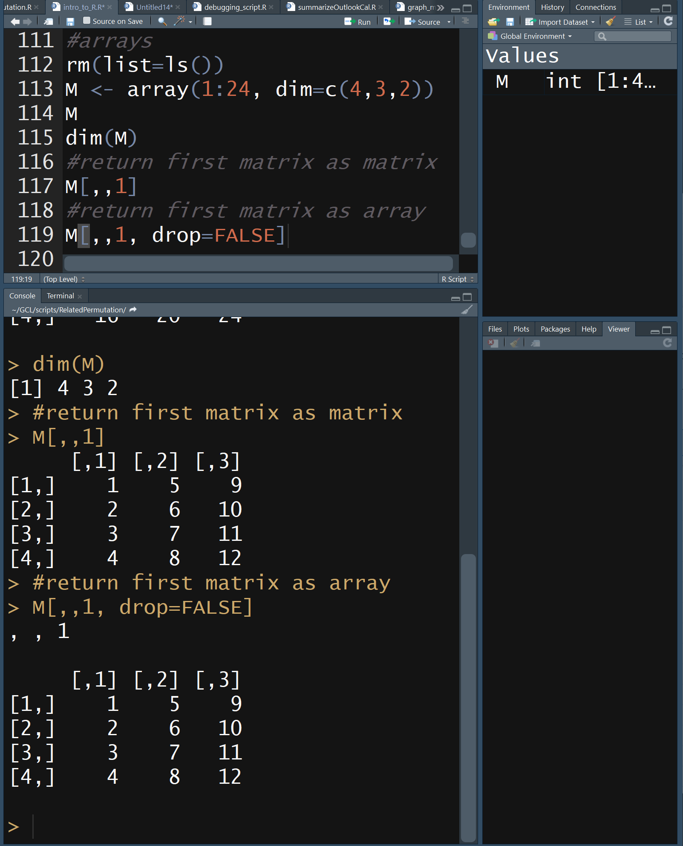
R Data Structures
Array
array(v,dim=c(row,col,m))
create array, v=vector of values, row=#rows, col=#cols, m=#matrices
Number of elements in v should equal row*col*m
Most matrix functions work on arrays
dim(); nrow(); ncol()
Subsetting arrays similar to matrices
array[row,col,matrix]

Slide 20
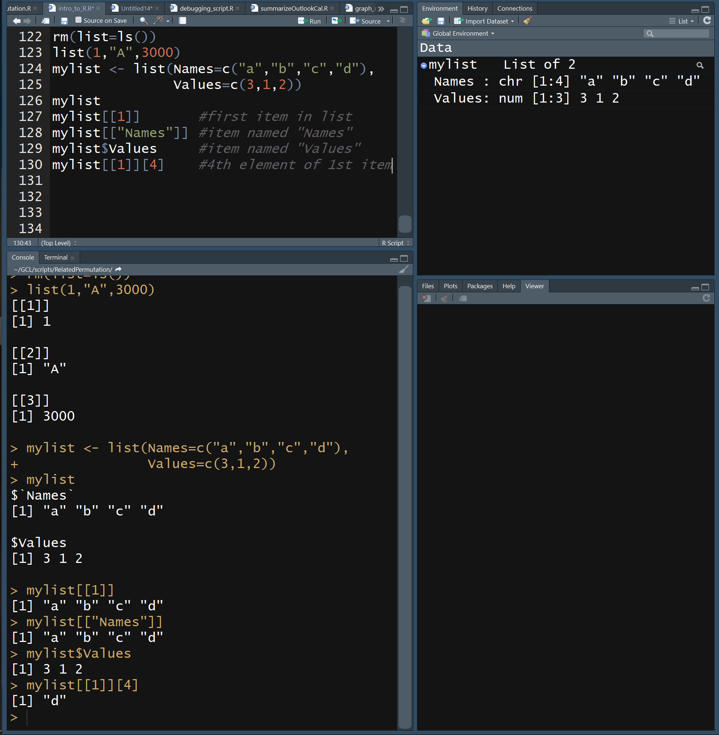
R Data Structures
List
Used to store elements of different types and structures, e.g. vectors, matrices, etc
list(x=v1, y=v2, …)
create list, x=name of 1st data structure, v1=value(s), y=name of 2nd data structure, v2=value(s)
Referencing specific values is similar to vectors, matrices, and arrays, but names can be used as well as indices. Number of brackets specifies hierarchical level of data

Slide 21
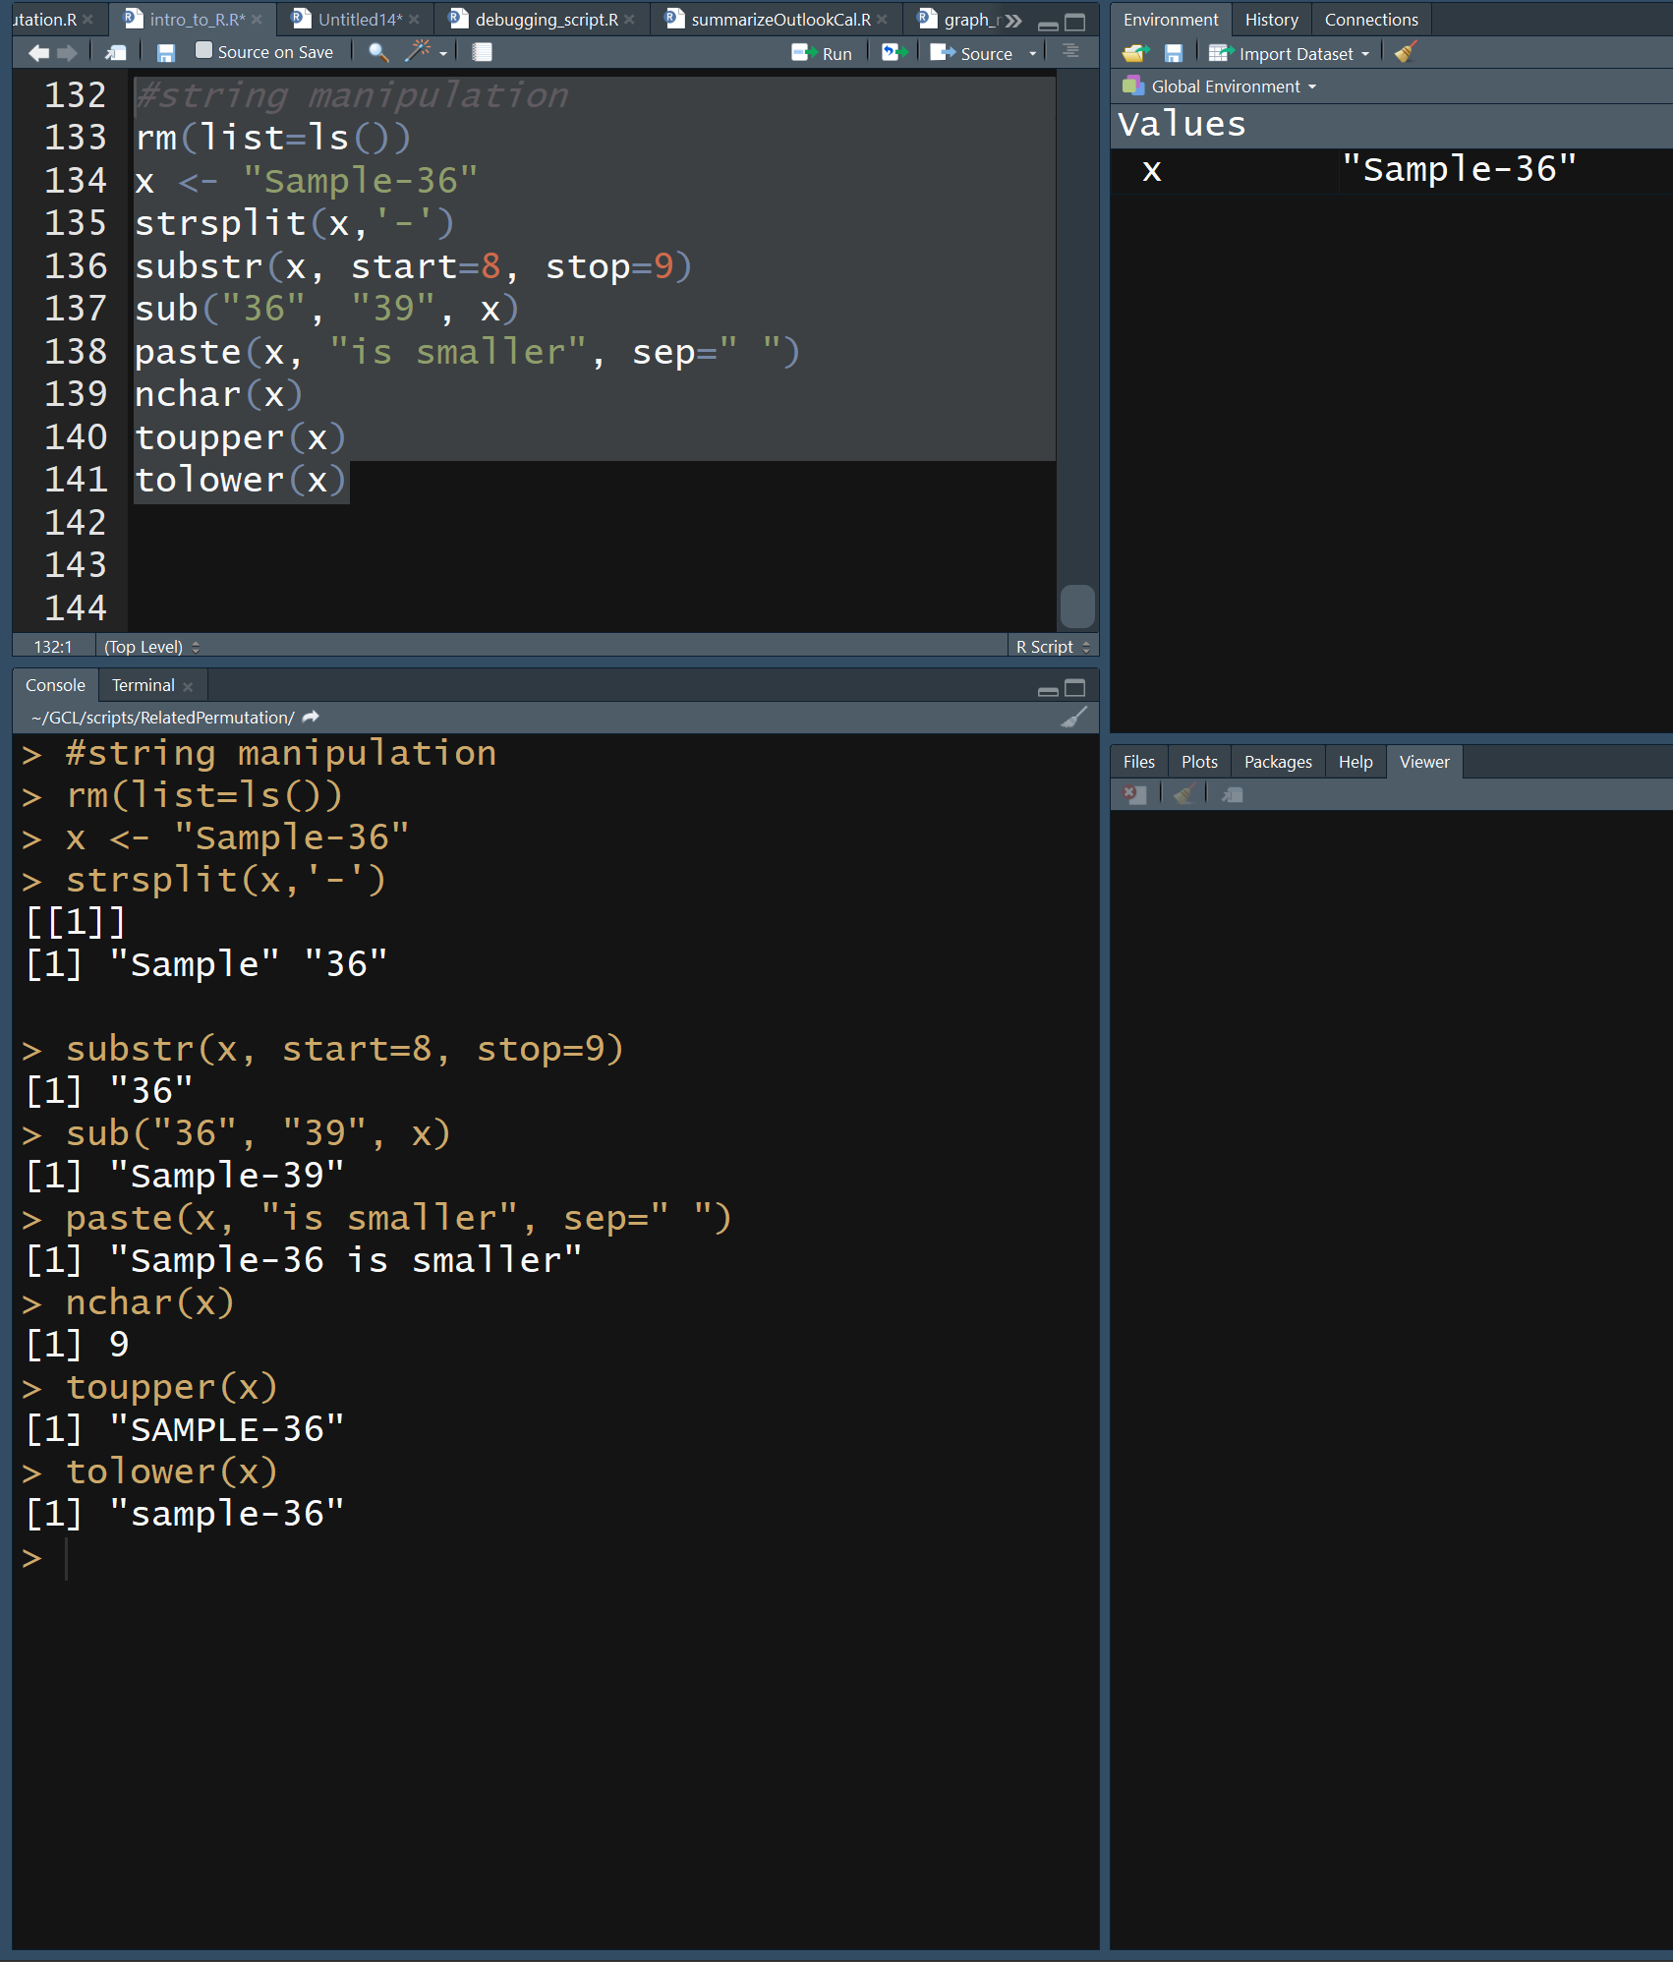
R String Manipulation
There are several tools for manipulating text strings. Here are a few examples
strsplit divide string into list
substr return part of string
sub substitute charcters
paste join strings into 1
nchar return # characters
toupper change case
tolower change case

Slide 22
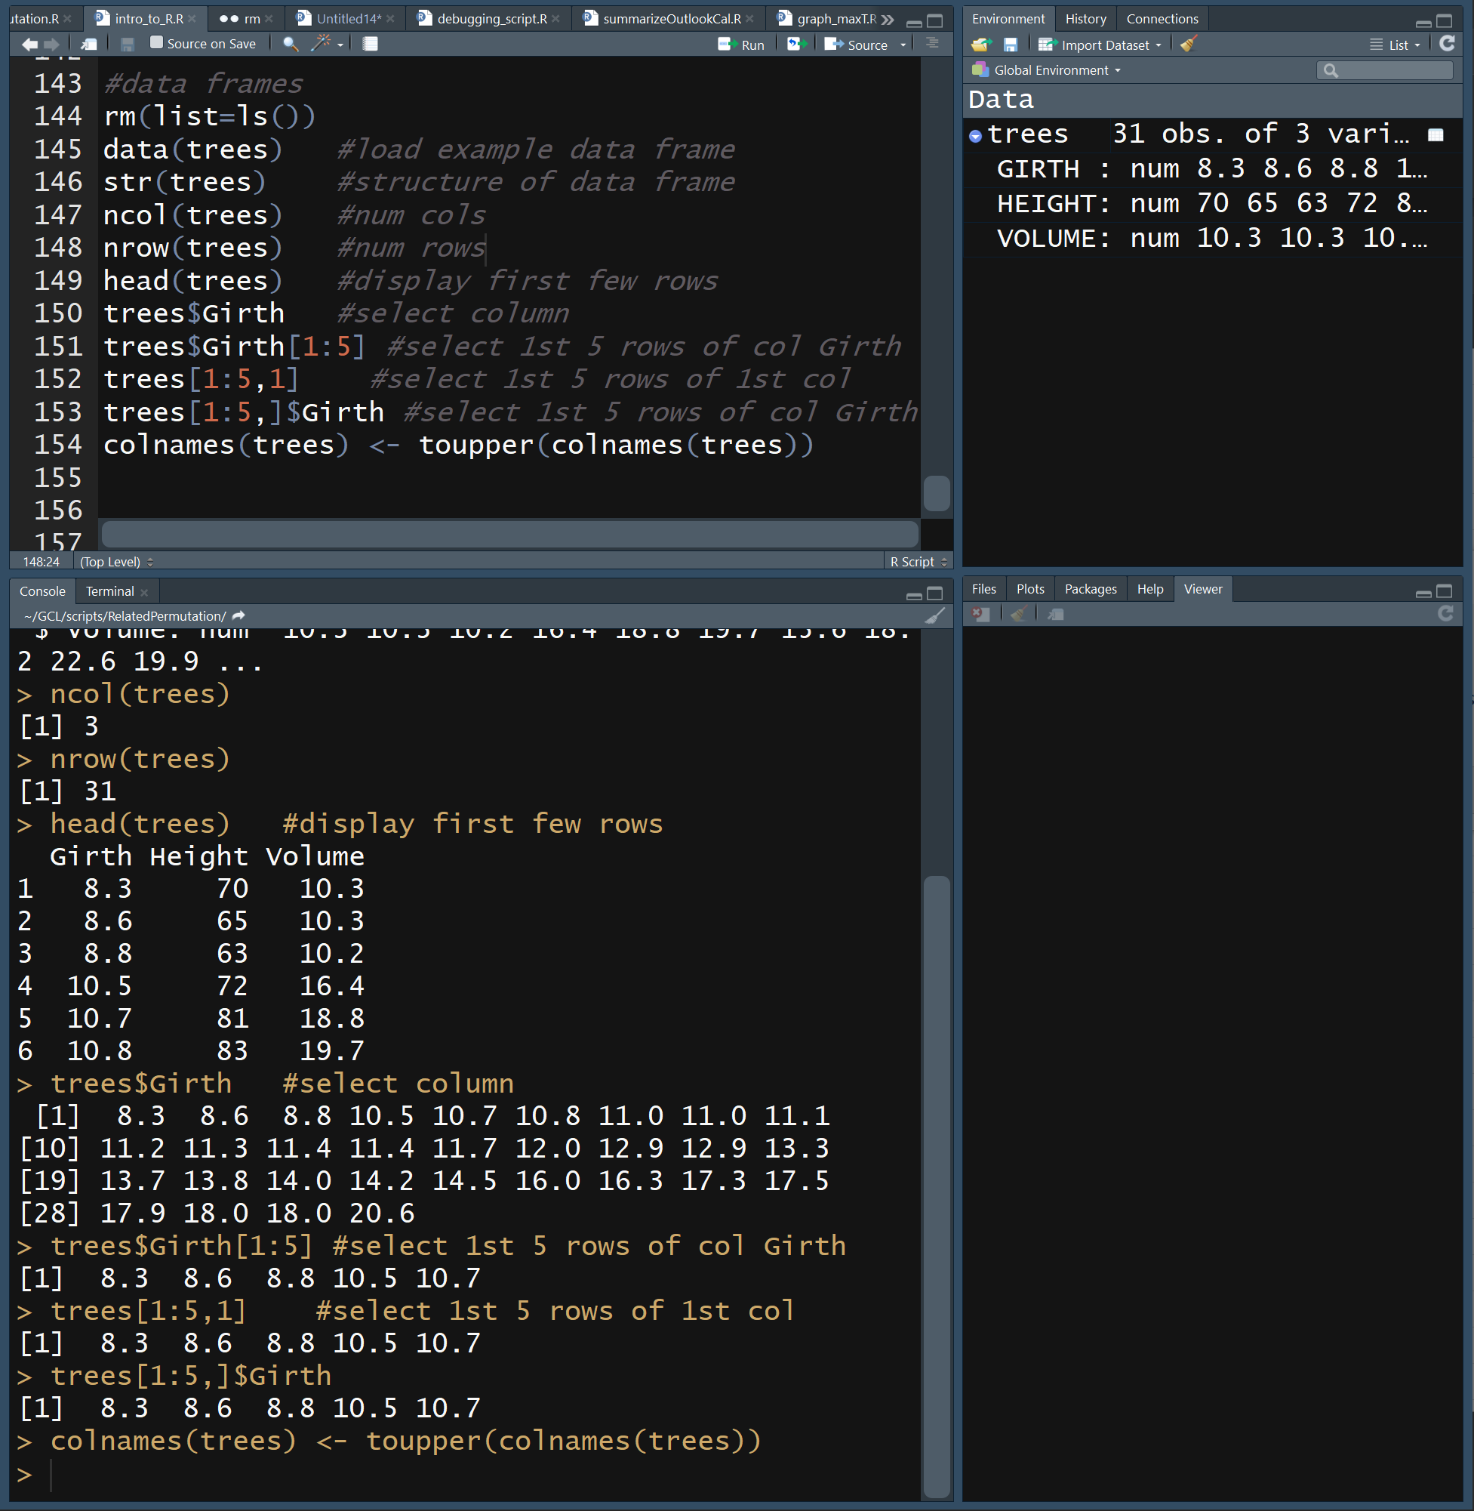
R Data Structures
Data Frame
Like a spreadsheet, each column is a type of categorization or measurement and each row is a different sample. Each column can have a different data type.
We can load an example data frame included with R called trees.

Slide 23
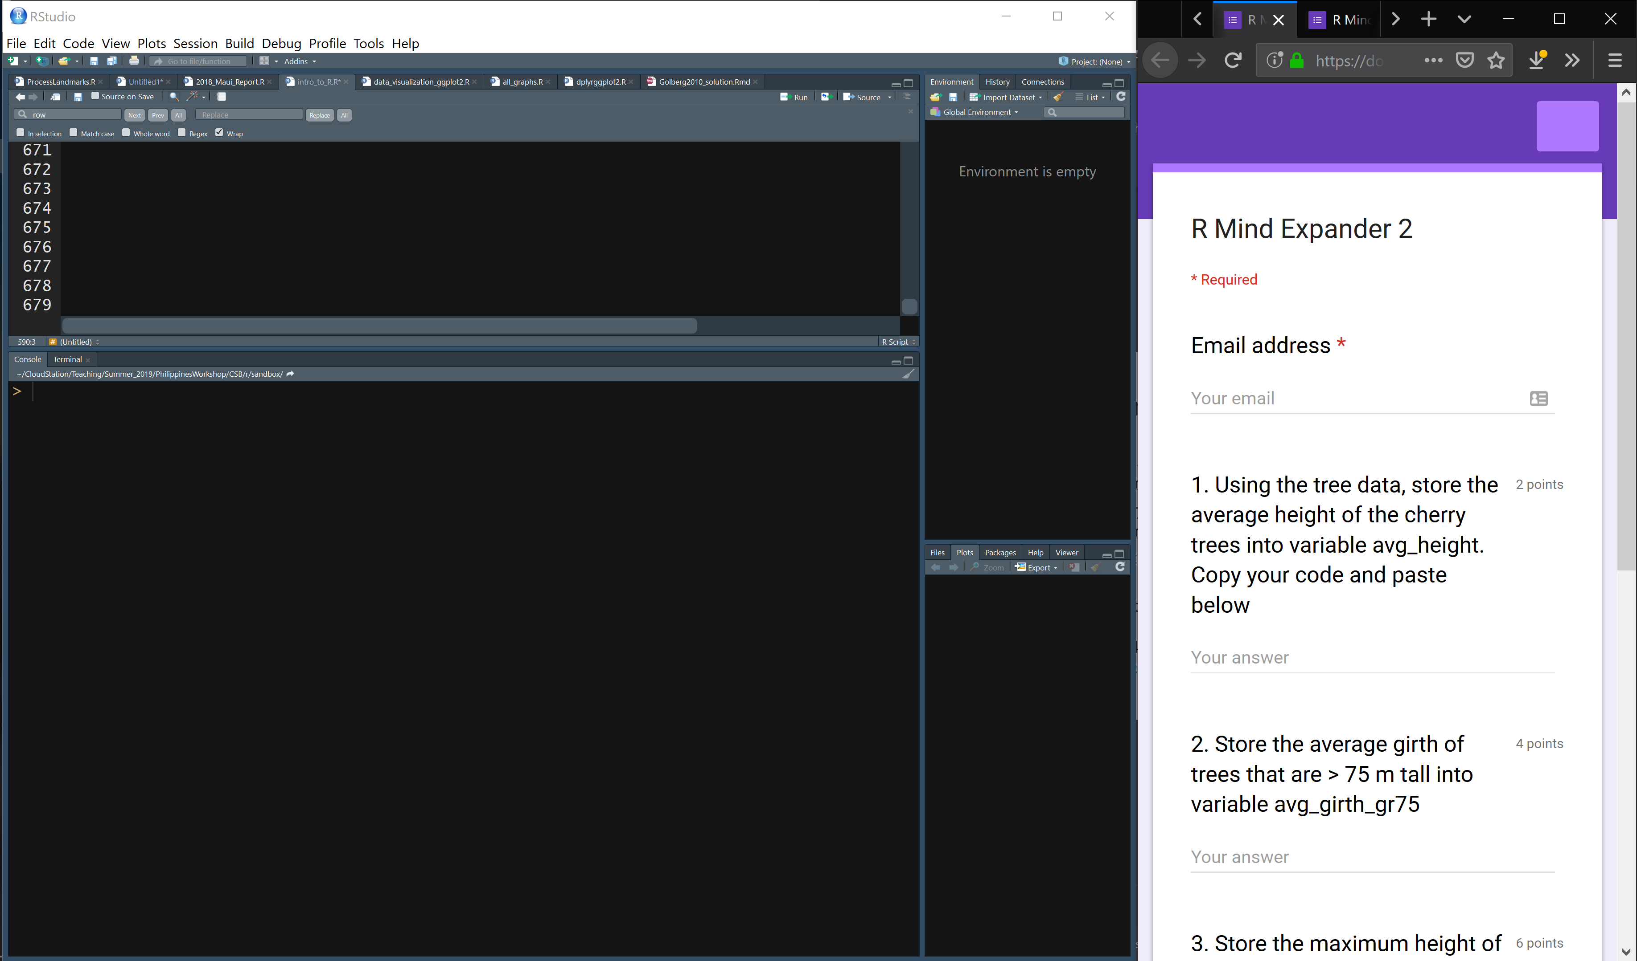
Link to Mind Expander 2 through github
Work independently or in groups to answer the questions

Slide 24
R Reading Data
You will typically read in your data from a comma or tab delimited file. It is read in as a data frame by default
Comma delimited files:
read.csv(“MyFile.csv”)
read.csv(“MyFile.csv”, header=TRUE) #csv has col headers
read.csv(“MyFile.csv”, sep=“;”) #separator is semicolon
read.csv(“MyFile.csv”, skip=5) #skip 1st 5 lines
Tab delimited files: read.table()
See the help pages for both read.csv and read.table for complete functionality

Slide 25
R Writing Data
You will typically write a dataframe to a csv or tab delimited file.
Comma delimited files:
write.csv(MyDF, “MyFile.csv”)
#don’t overwrite
write.csv(MyDF, “MyFile.csv”, append=TRUE)
#no header row
write.csv(MyDF, “MyFile.csv”, col.names=FALSE)
See documentation for write, write.csv, write.table for full functionality

Slide 26
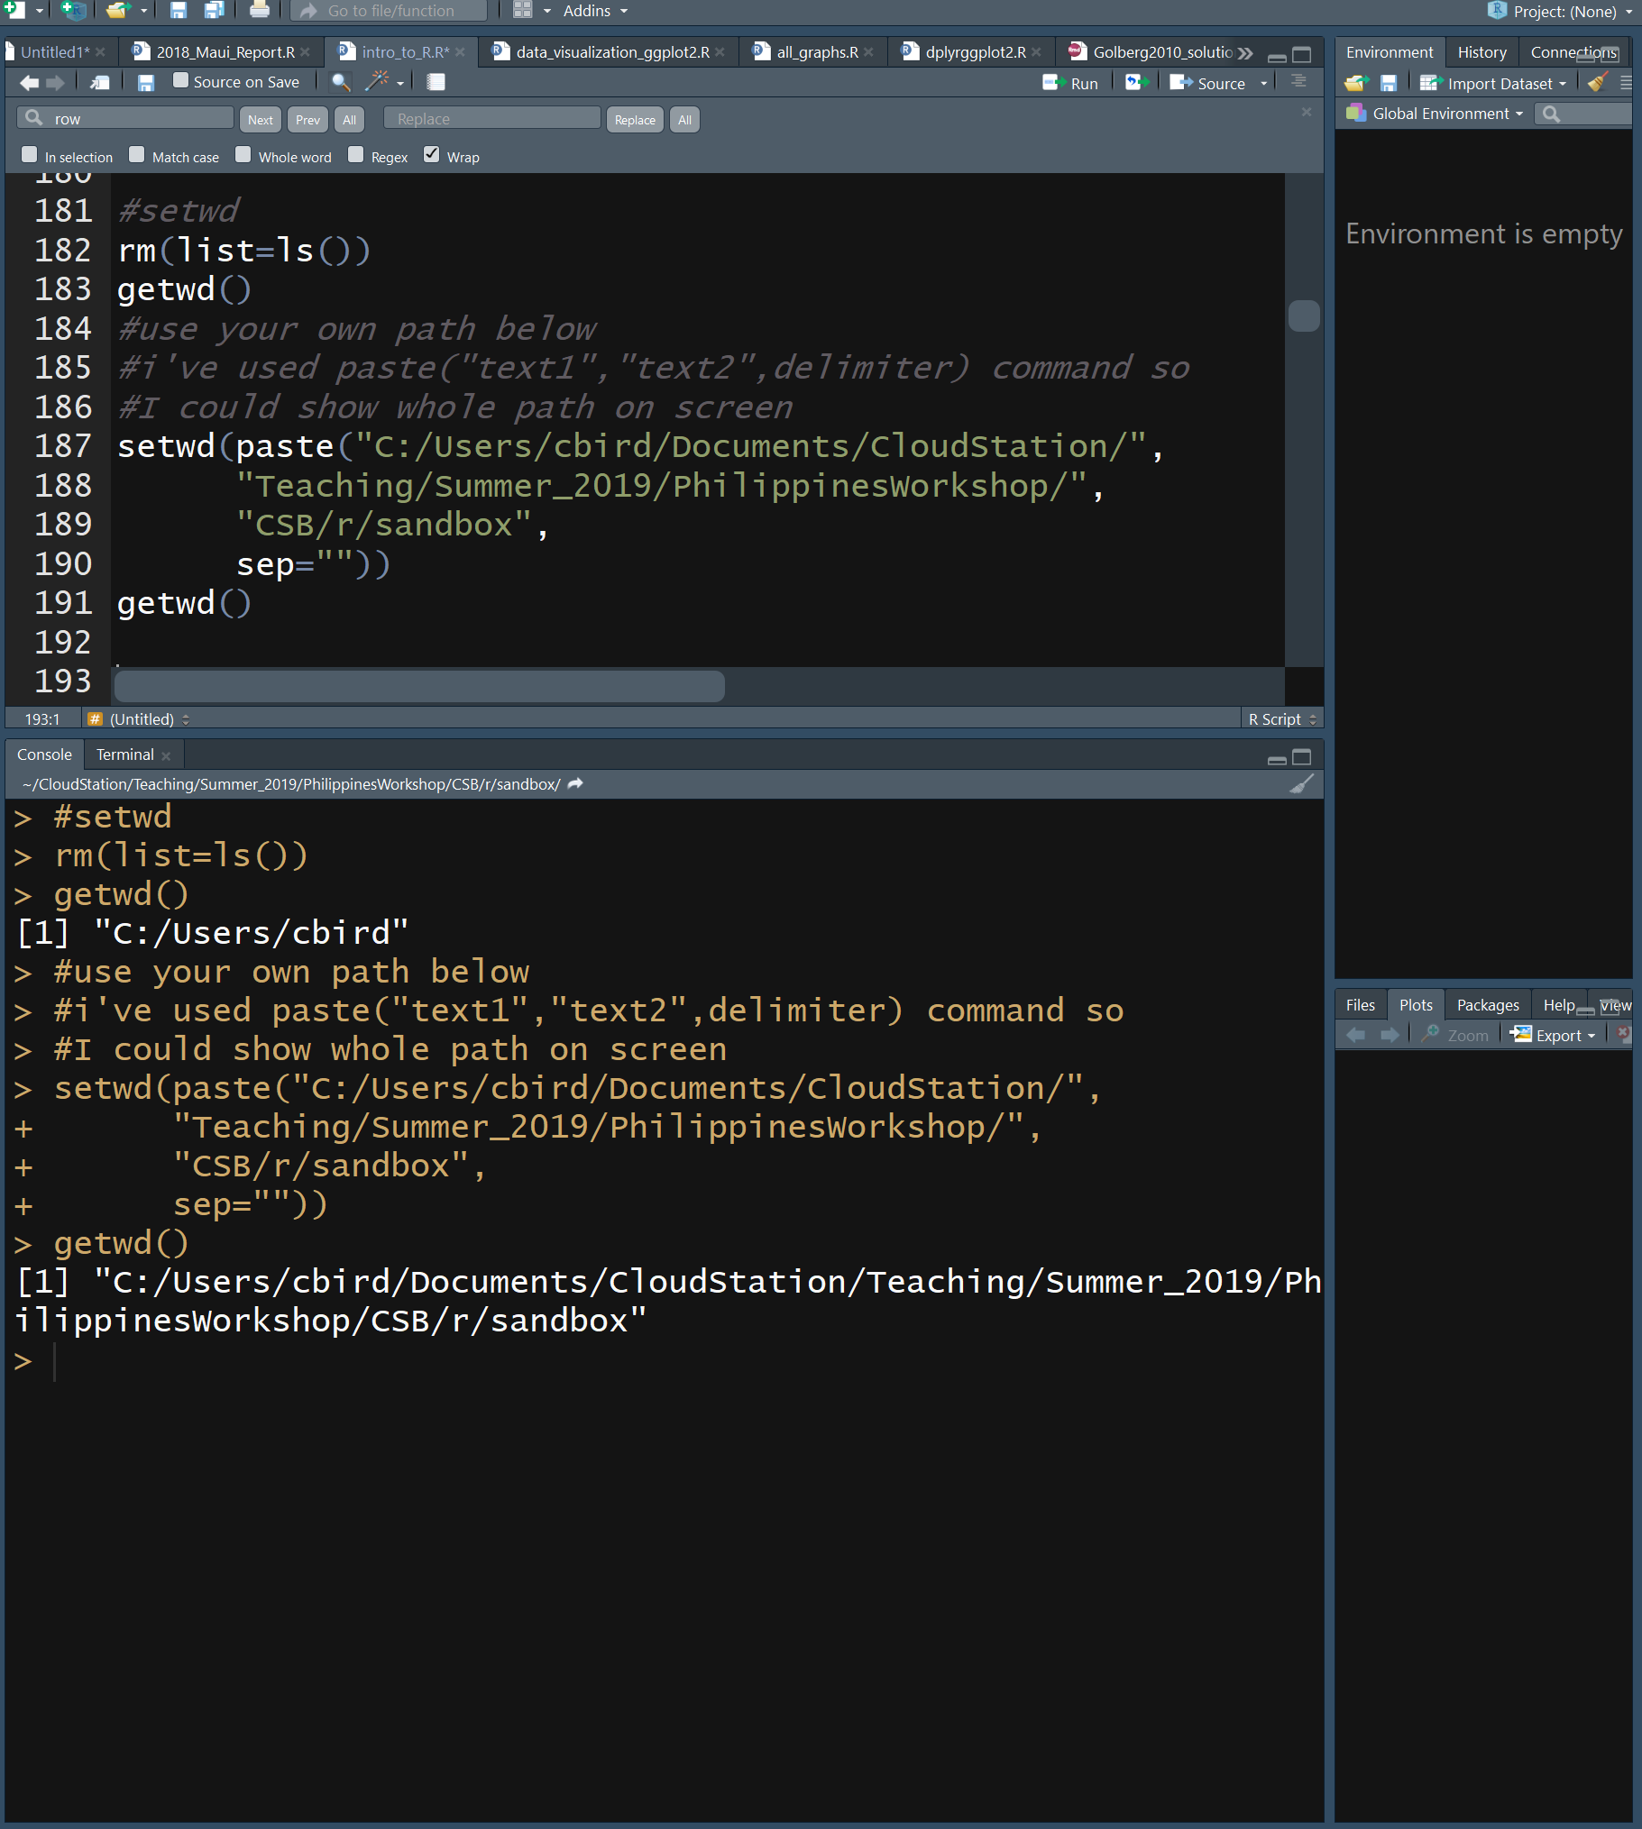
R Working Directory
Before you start reading and writing files, it’s important to know where the working directory is
getwd(“path”)
shows where you are
setwd(“path”)
changes where you are
Note, root in windows is C:/ rather than /

Slide 27
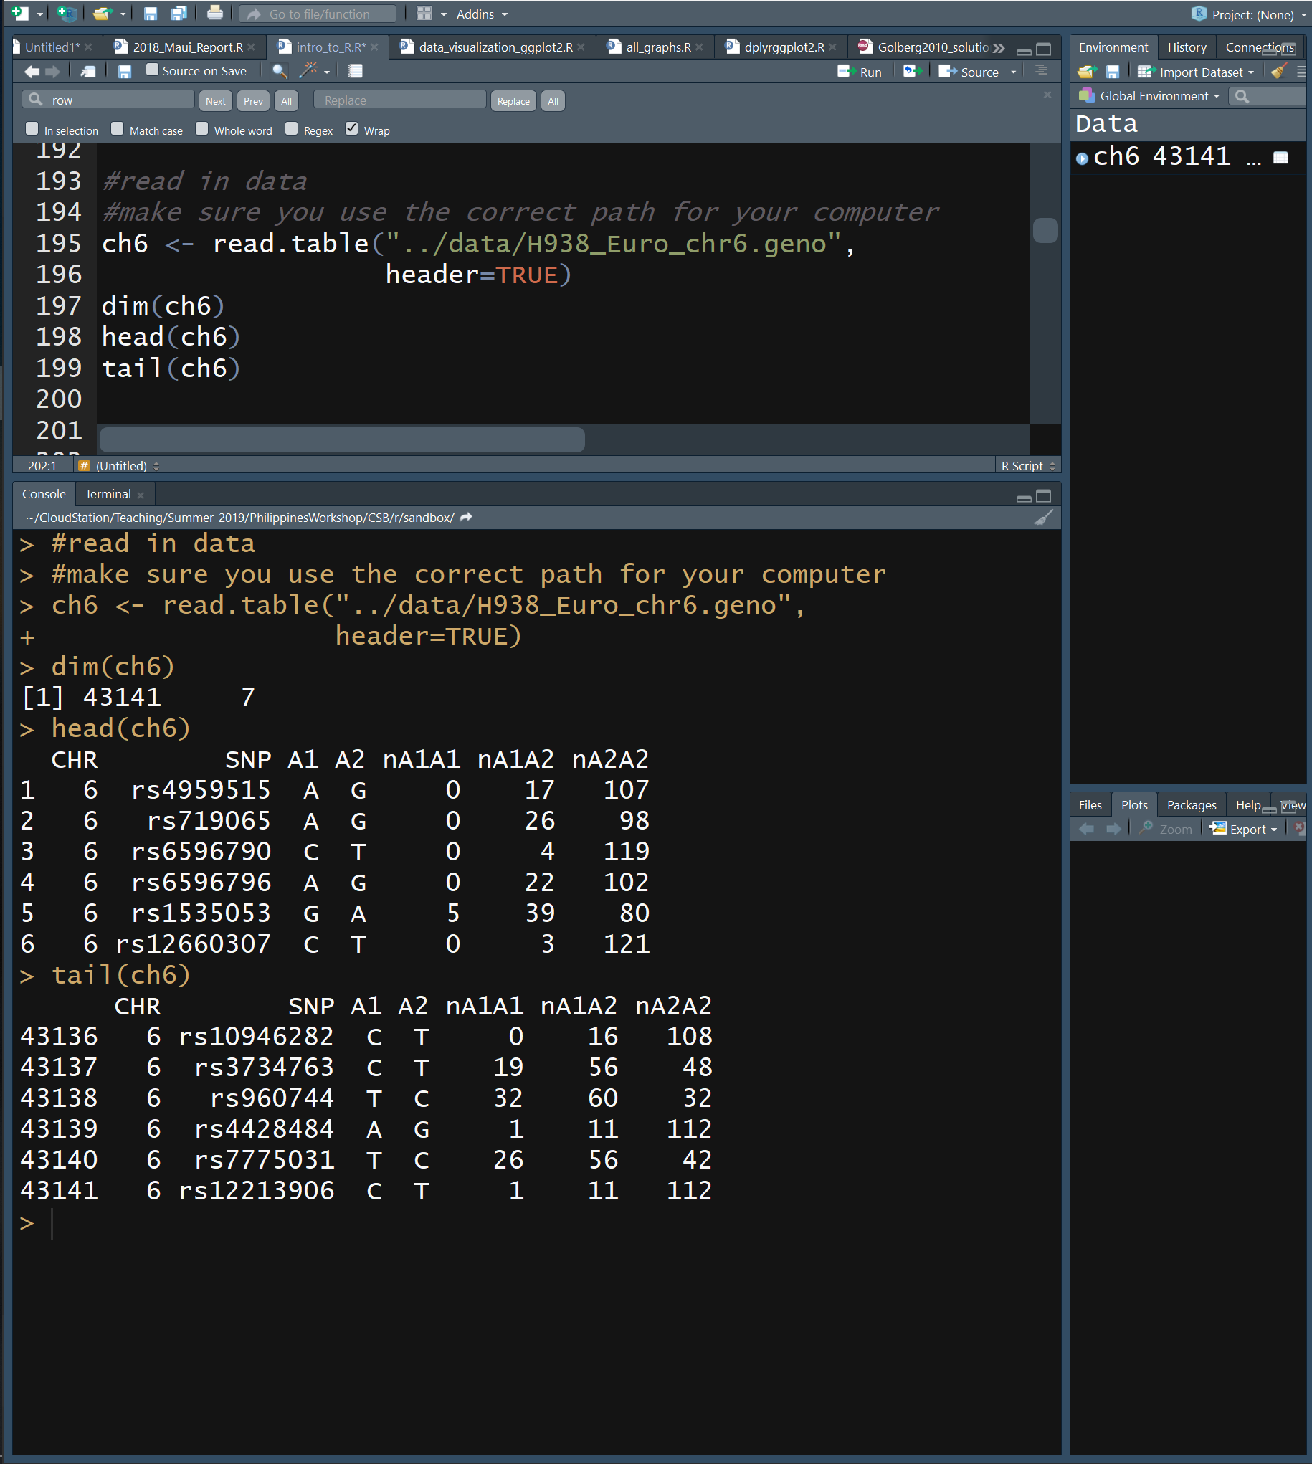
Read in H938_Euro_chr6.geno
This file contains 7 columns
CHR – chromosome
SNP – single nucleotide polym
A1 – allelic state 1
A2 – allelic state 2
nA1A1 - # homozyg A1
nA1A2 - # heterozyg
nA2A2 - # homozyg A2

Slide 28
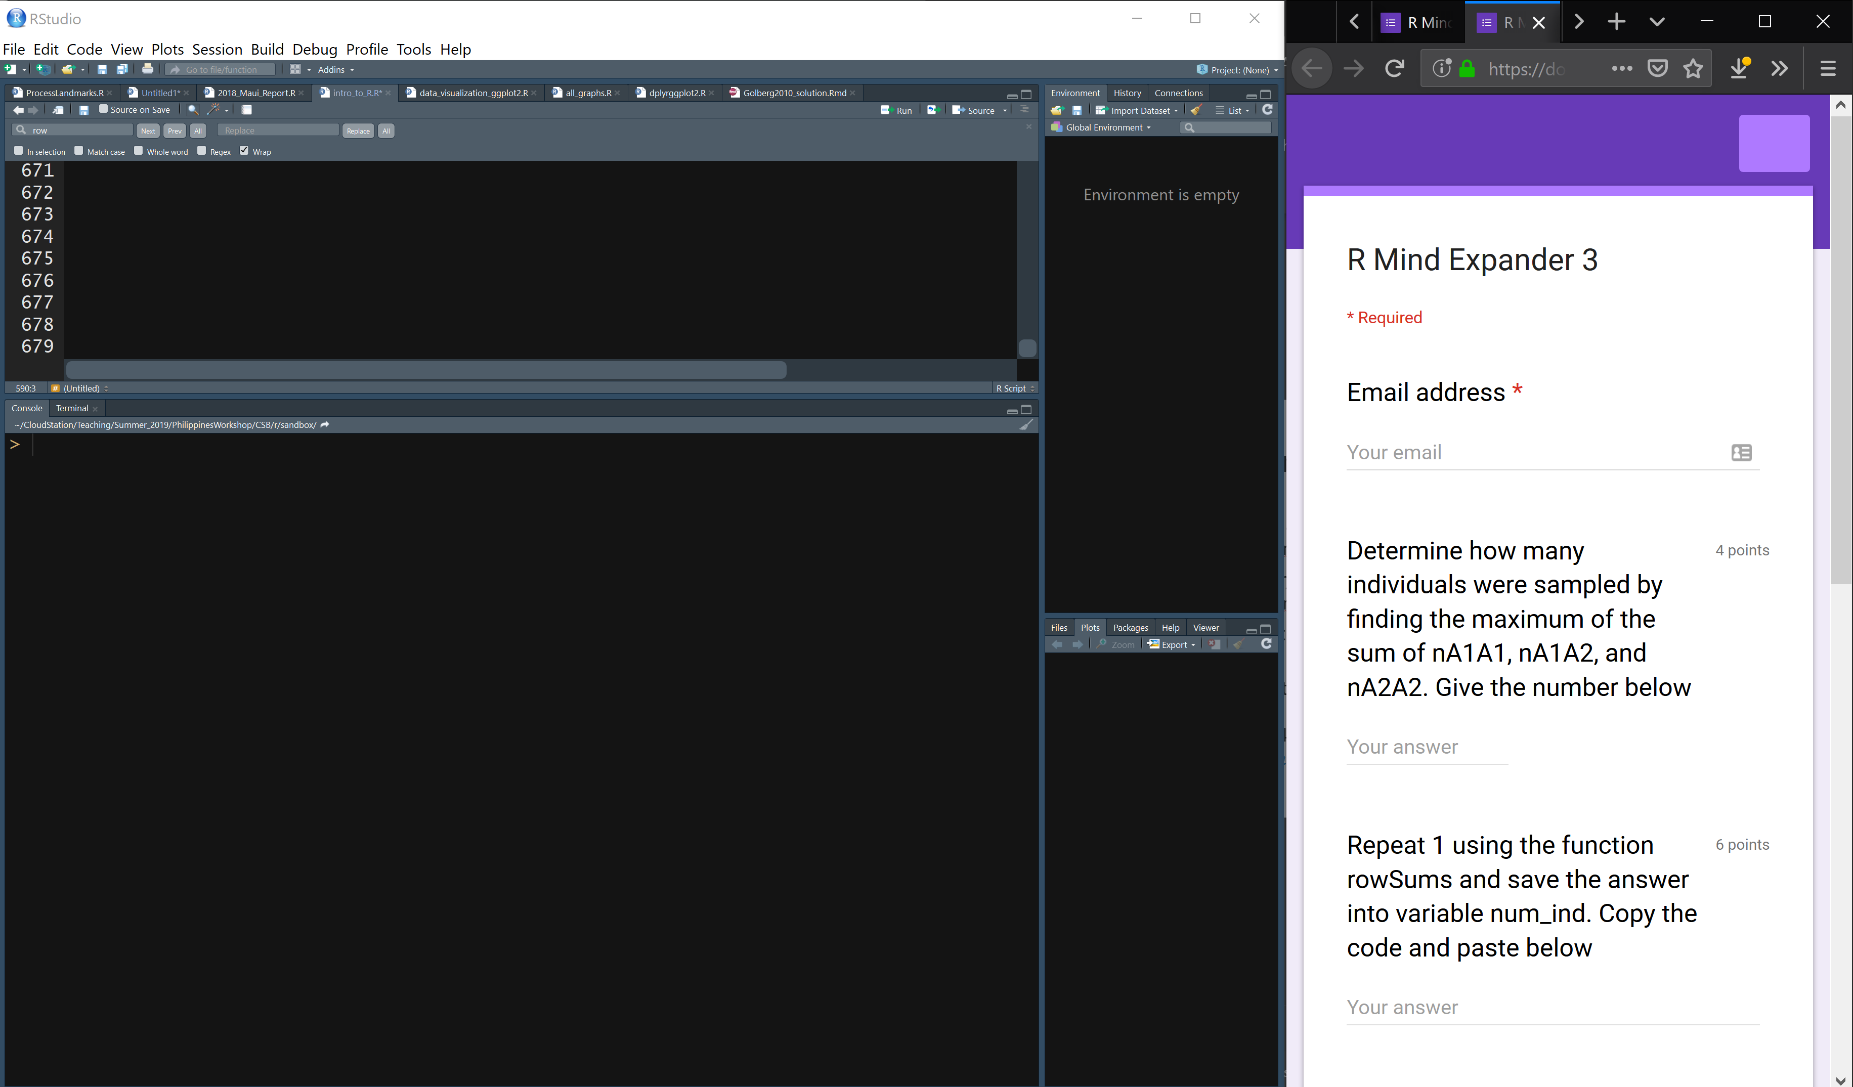
Link to Mind Expander 3 through github
Work independently or in groups to answer the questions

Slide 29
R Scripts
Scripts are text files that contain the commands you give to R
Scripts have many advantages in biological research
Recycling – similar analyses can be adapted quickly
Automation – if you make a mistake, it’s easy to fix and redo analysis
Documentation – analyses are precisely recorded for evaluation
Share – submit with your manuscript, review for errors

Slide 30
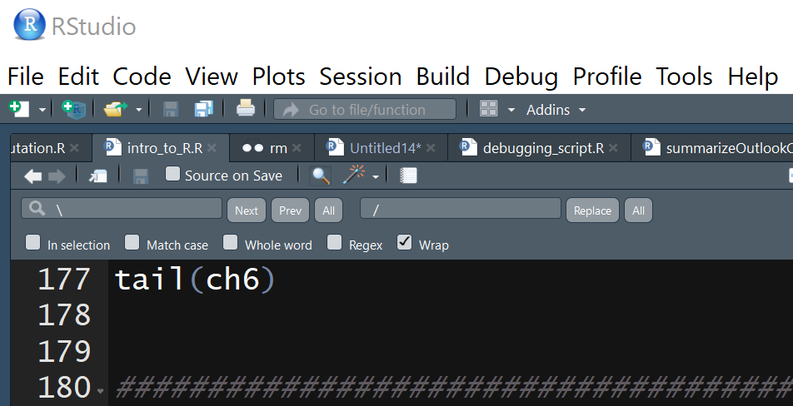
Writing Good Code
Do as I say, not as I do. I don’t like a lot of spaces, and I had to eliminate them to make the code fit in the power point presentation
Use descriptive names with CamelCase or words_separated_by underscores
Files – model_fitting.R
Variables – body_mass
Functions – calculate_cv
Be consistent in use of spaces
X <- 5*7 or X <- 5 * 7 not X<-5*7
M <- matrix(25, 5, 5)
Z <- mean(m, na.rm == TRUE)
Use indenting to organize hierarchical code
if (b == 5) {
do(something)
} else {
do(something_else)
}
Auto formatting in R Studio
Code / Reformat Code
Code / Reindent Lines

Slide 31
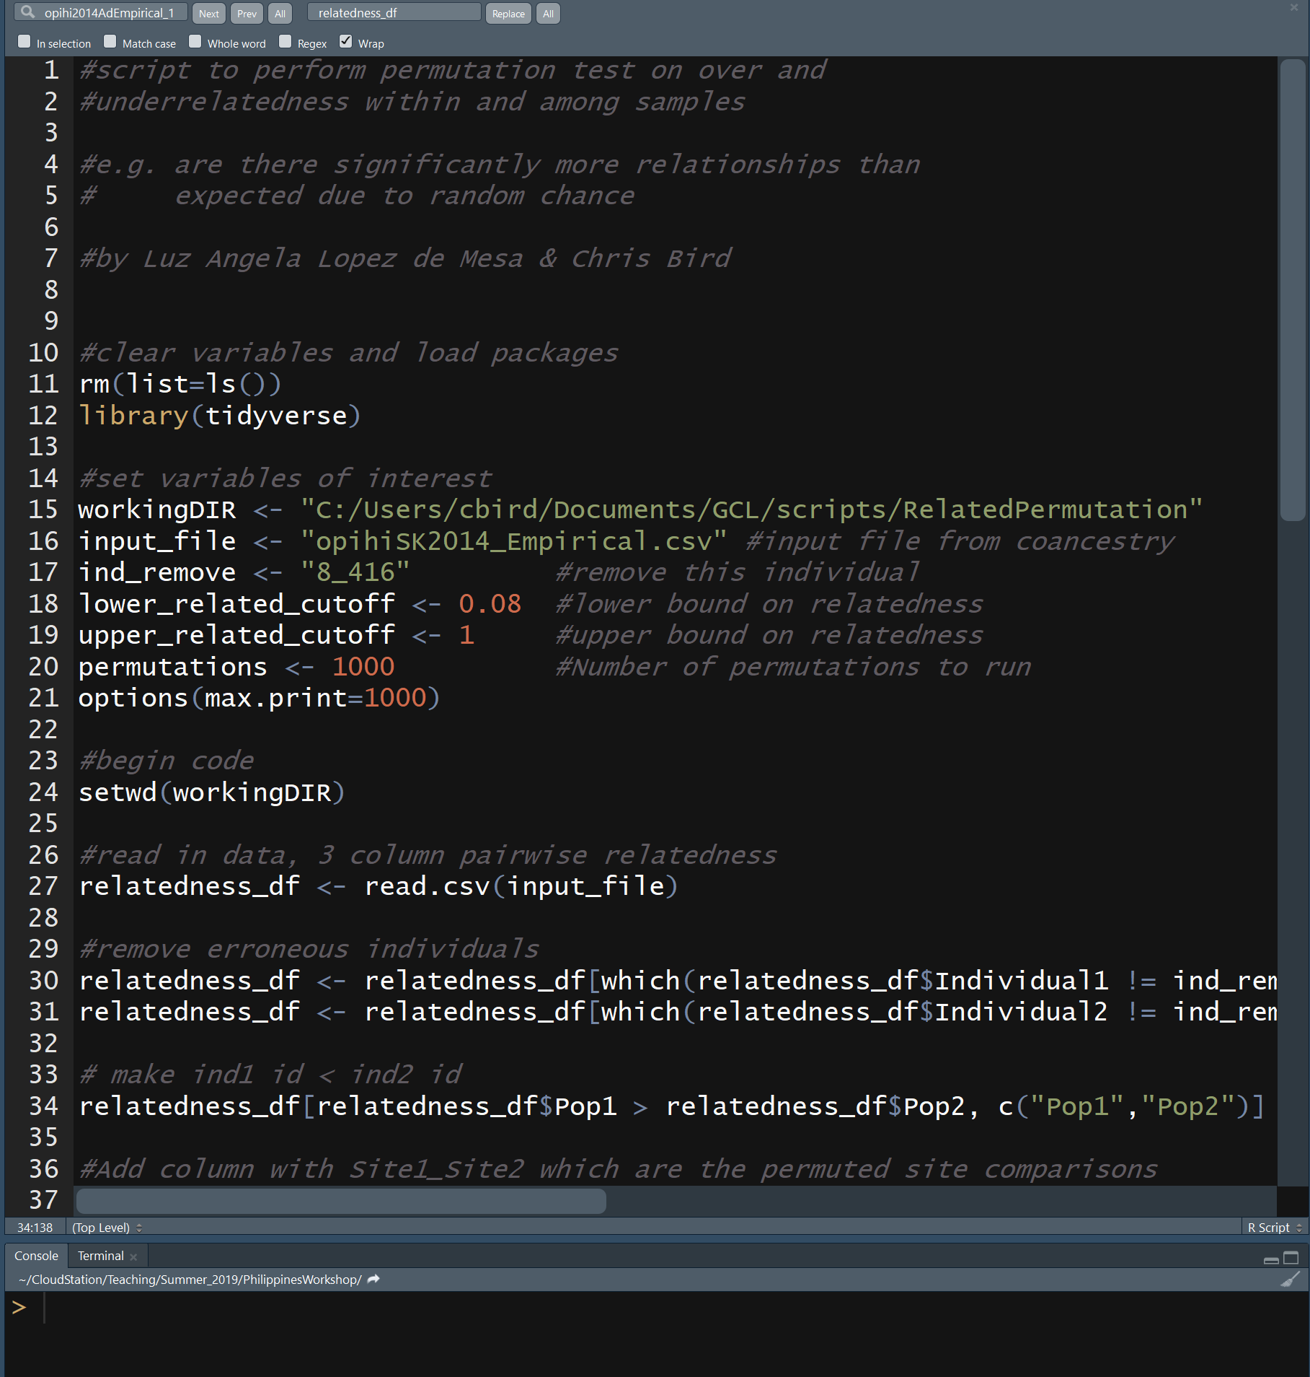
Writing Good Code
Document your code so that it is easy to understand what you are trying to accomplish
The first line(s) of your R script should describe what the R script does and how to use it
Provide descriptions of what your blocks of code do in the line(s) preceding the block of code
Use tabs to align comments
Use empty lines to break up sections of code
Load libraries and set variables at the beginning
Don’t type this in

Slide 32
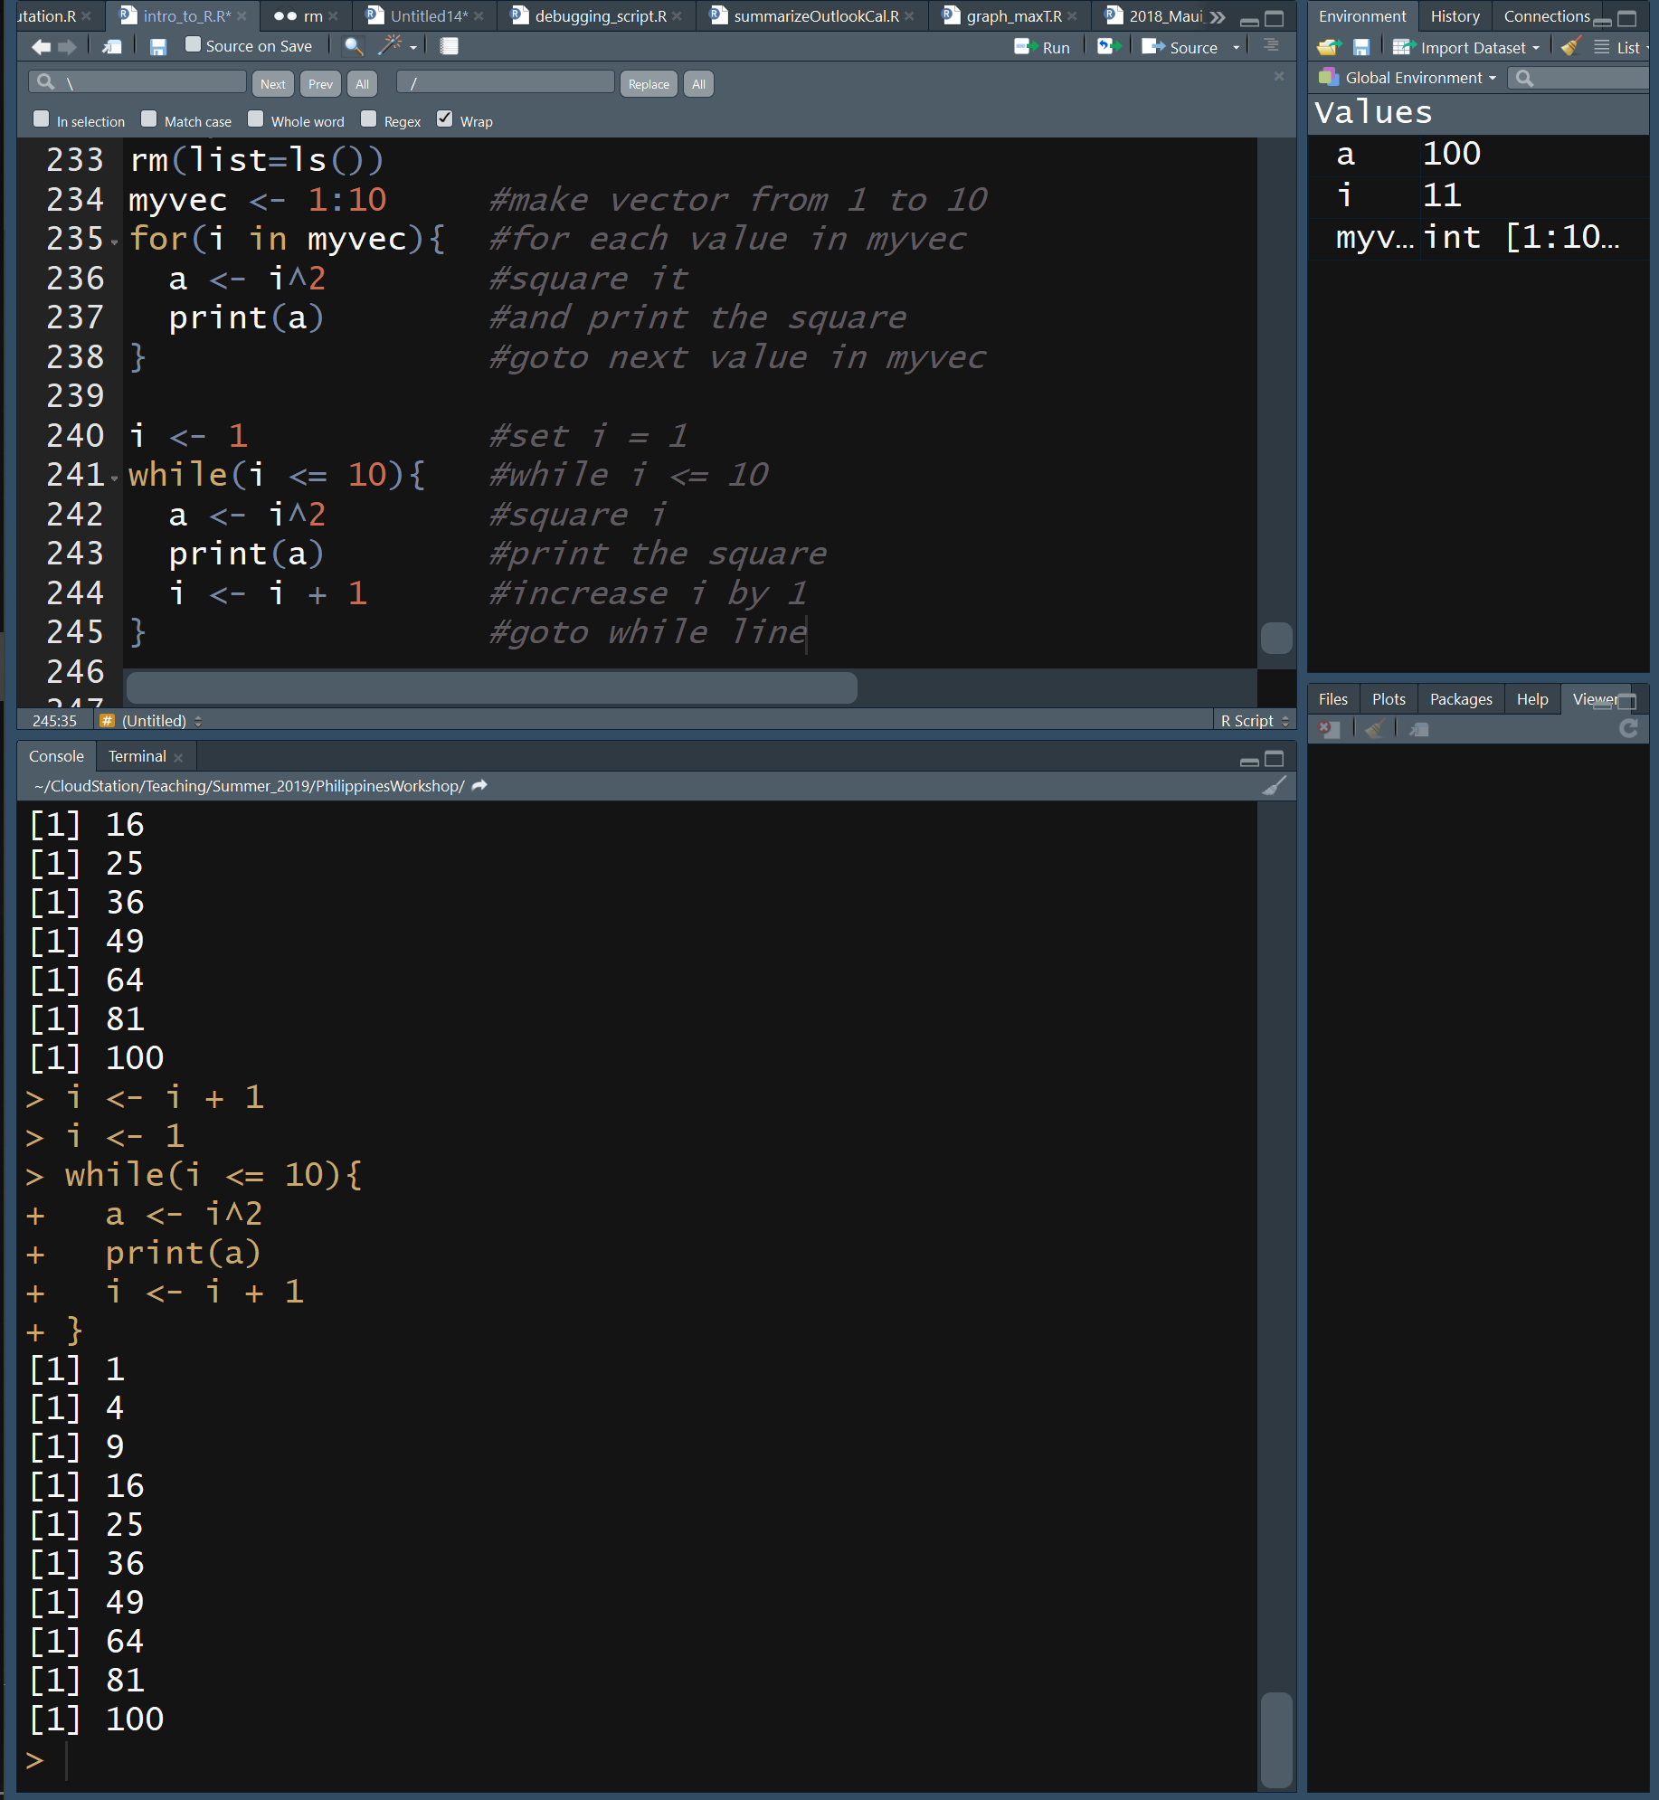
R Loops
Allows you to perform repetitive tasks in a few lines of code
Anatomy of the for loop
for(i in list_or_vector){
Do something with i
}
Anatomy of the while loop
while(condition is TRUE){
Execute commands
Update condition
}
Exit a loop using break
if(i >7){break}

Slide 33
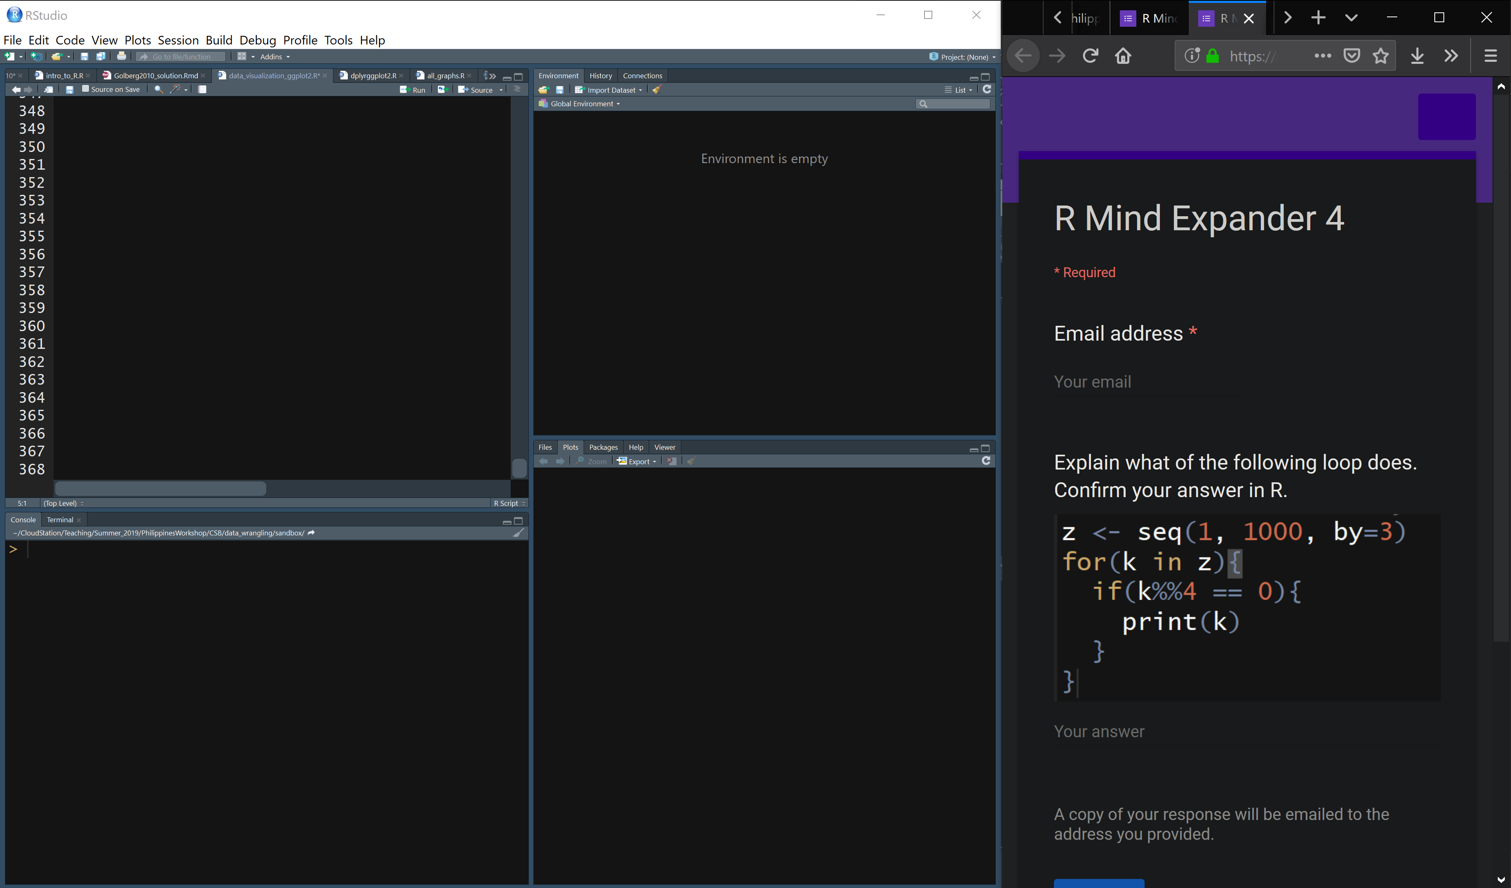
Link to Mind Expander 4 through github
Work independently or in groups to answer the questions

Slide 34
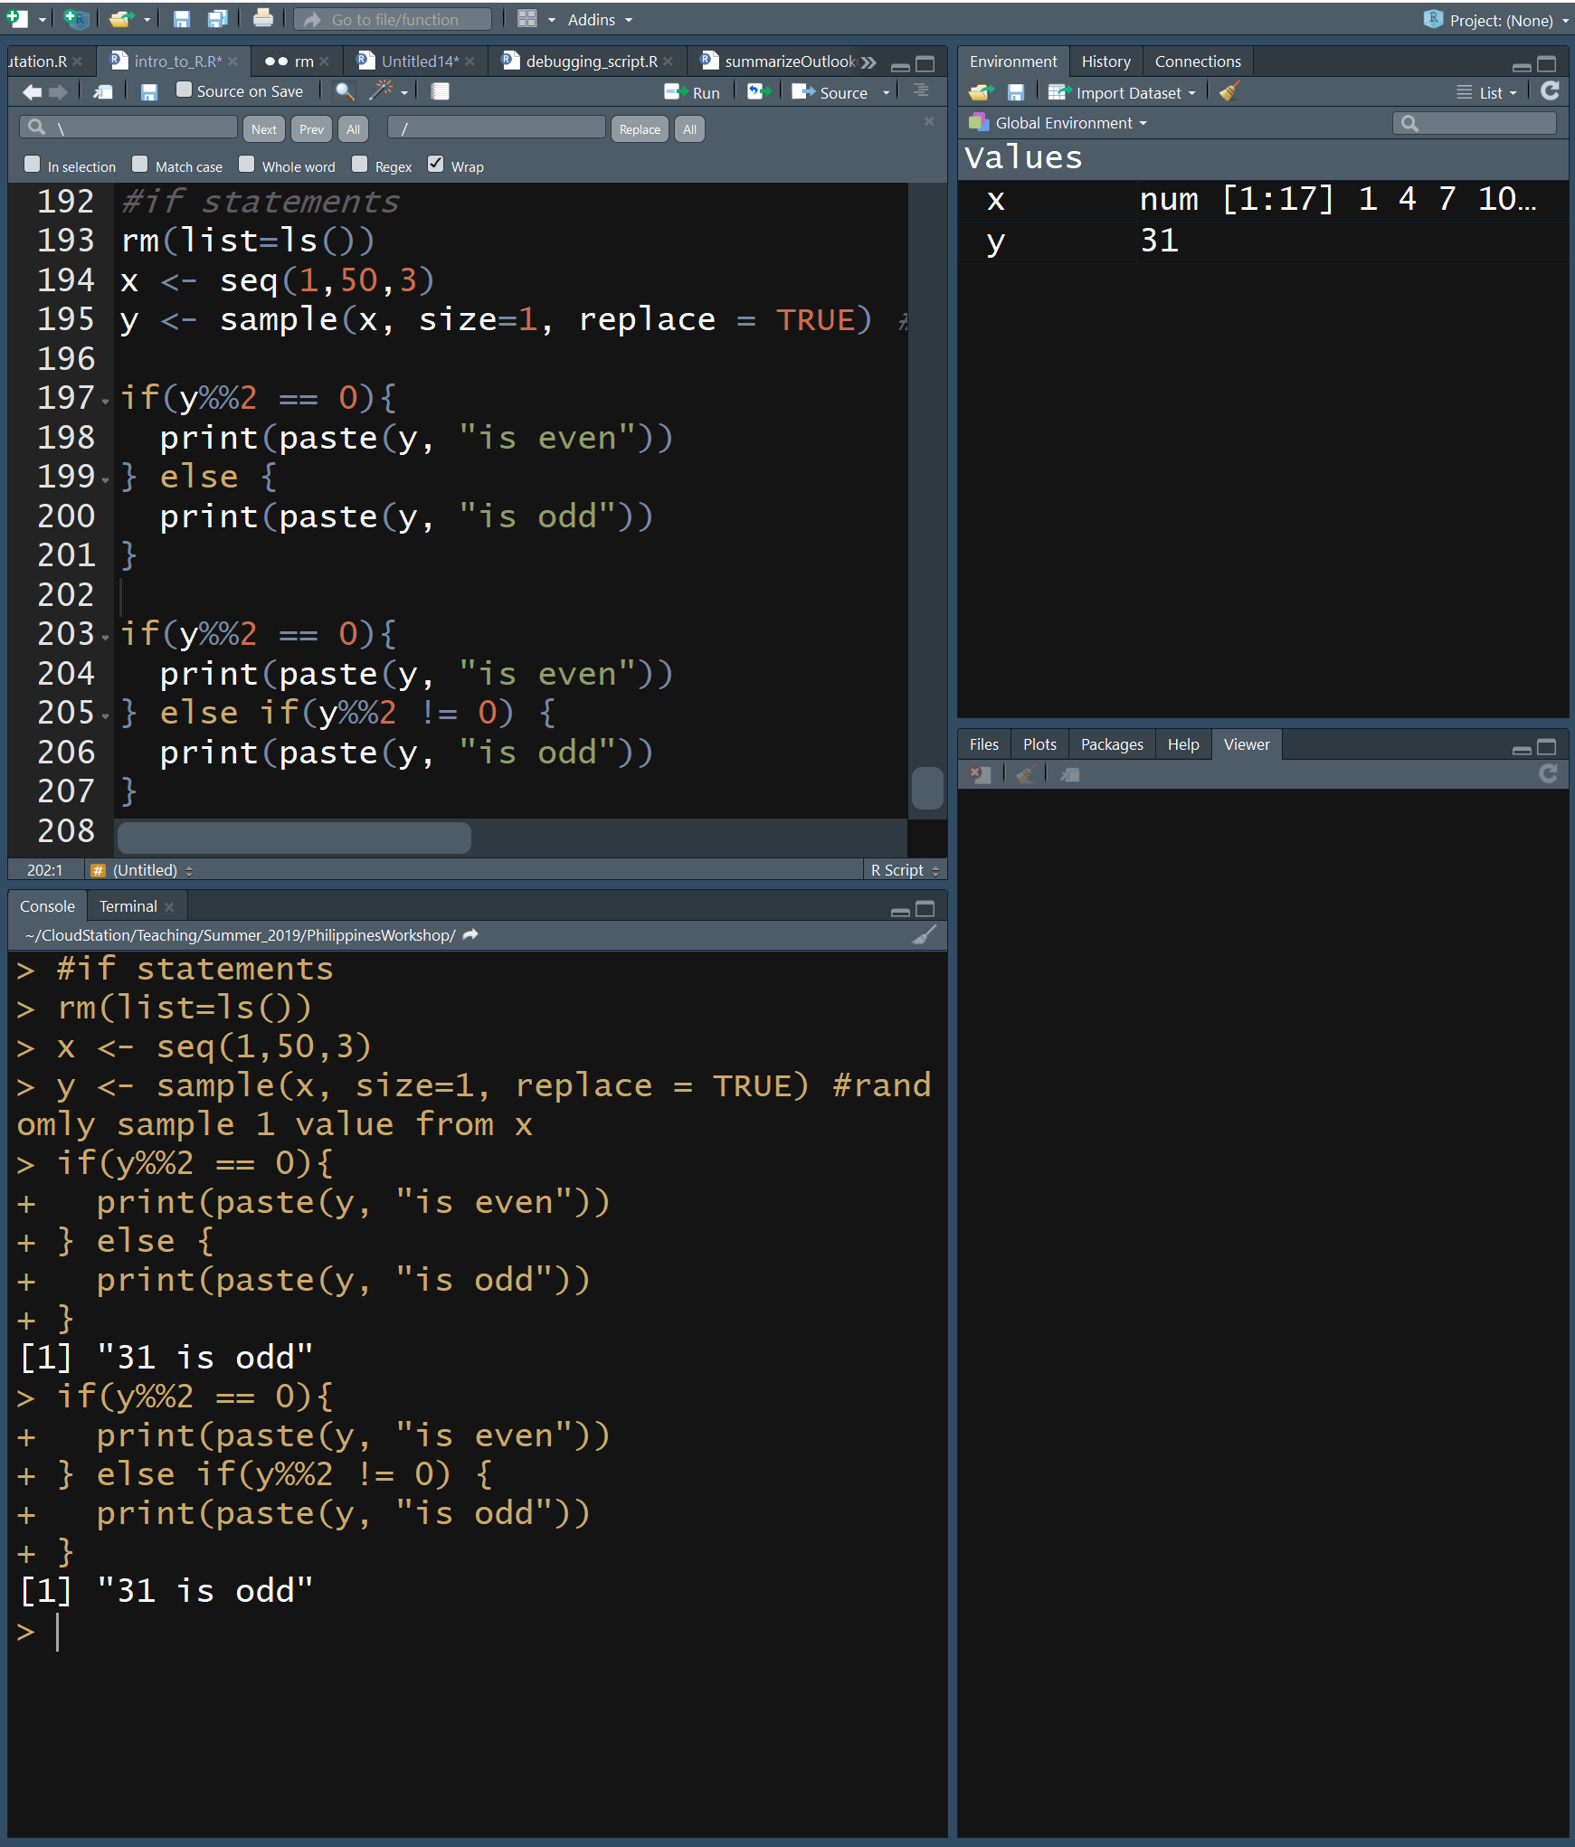
R If-Then Statements
Run code conditionally
Anatomy of the if statement
if(a condition is TRUE){
execute these commands
} else {
execute these other commands
}
For multiple conditions, replace
} else { with
} else if(2nd condition is TRUE){

Slide 35
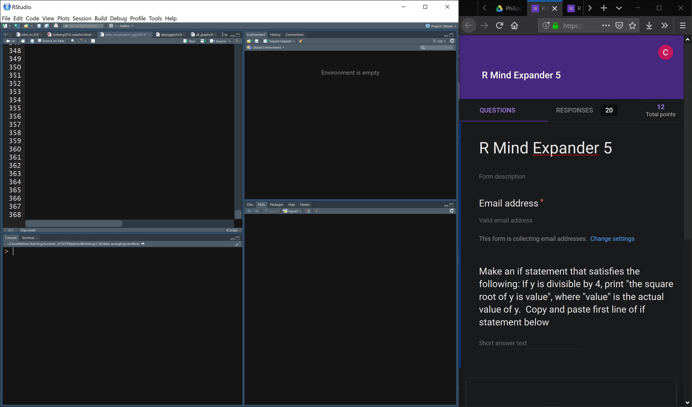
Link to Mind Expander 5 through github
Work independently or in groups to answer the questions

Slide 36
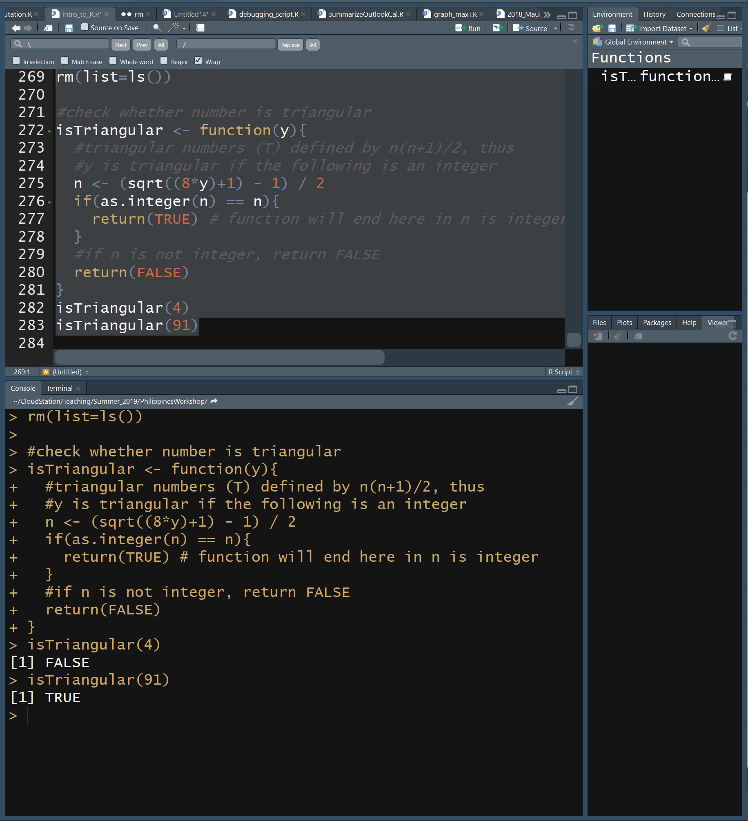
R Functions
Thus far we have used several built-in functions of R
seq, for, if, while, print, sample, paste, dim, head, tail, getwd, setwd, …
It is also possible to define your own functions
MyFunction <- function (optional arguments){
Execute commands
return(value) # optional
}
Functions must be read in before calling them
Like Cebu City, what happens in a function, stays in a function

Slide 37
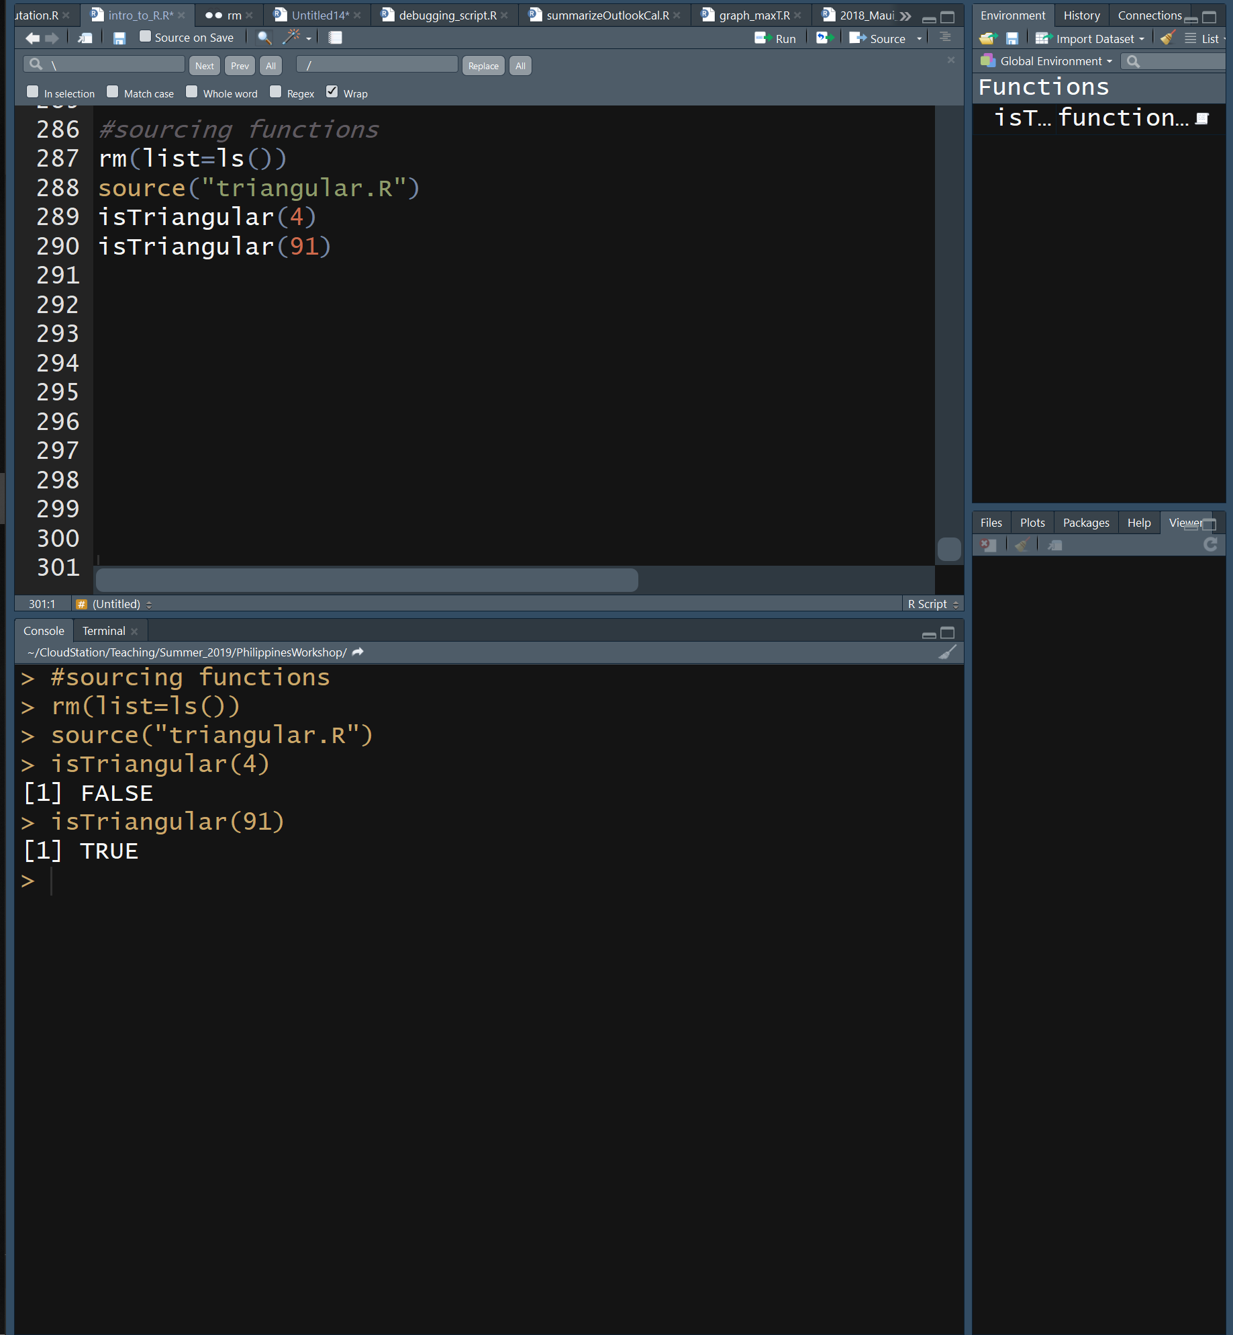
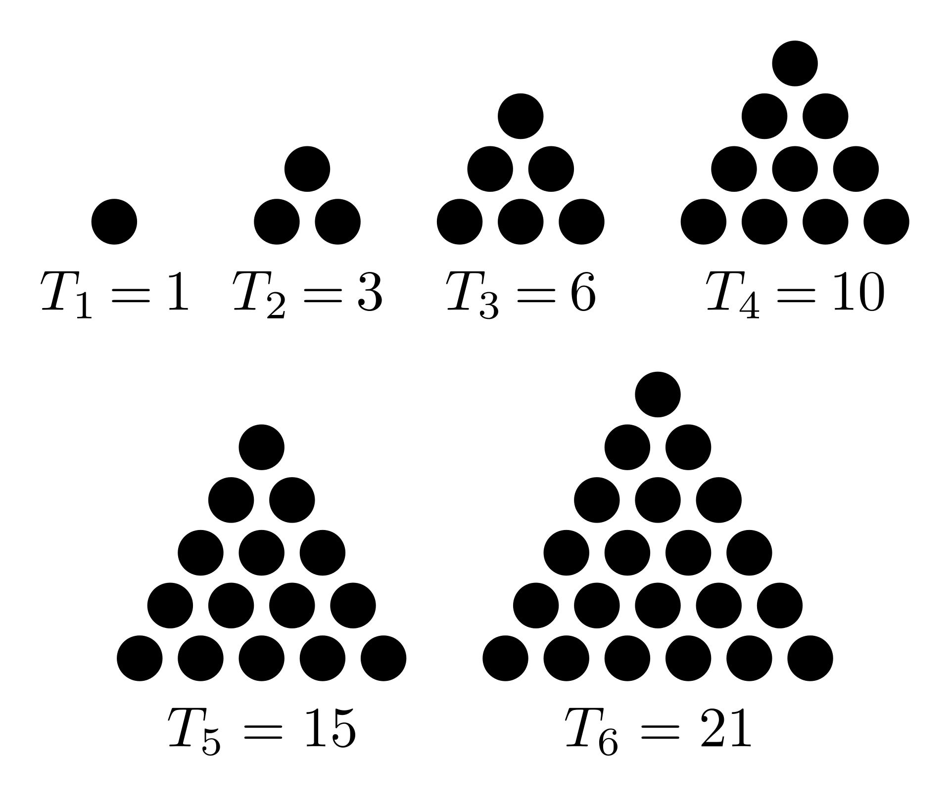
Sourcing R Functions
Functions can be saved in a file and called with the source() command
Save isTriangular to the file triangular.R in a new R script then source it

Slide 38
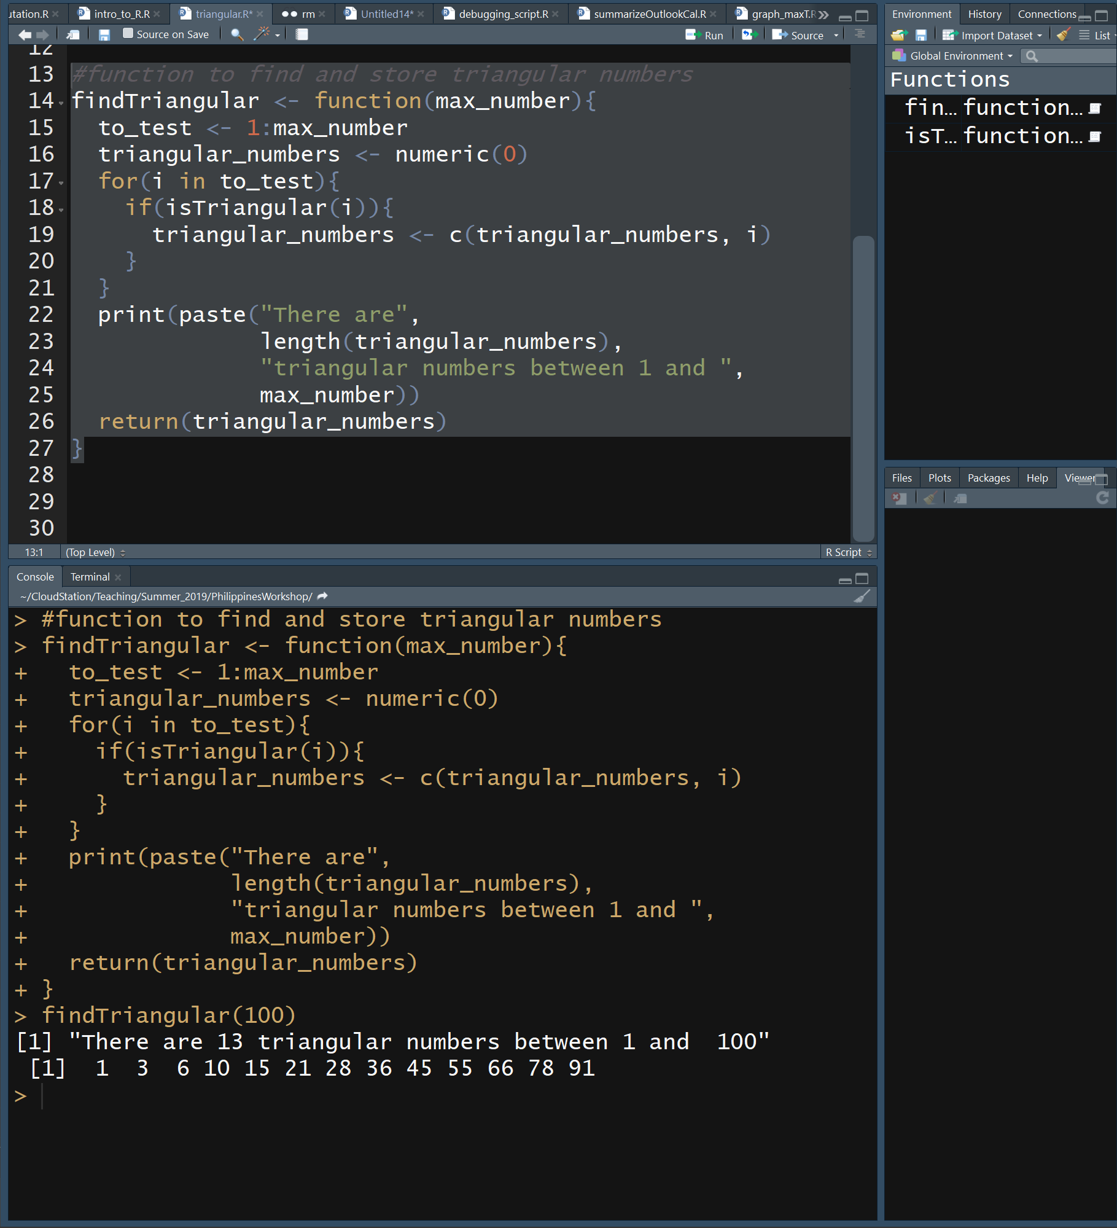
R Functions
Add another function to triangular.R that returns all triangular numbers between 1 and x
Test it
Save the file and close it
Source triangular.R and run the isTriangular and findTriangular functions

Slide 39
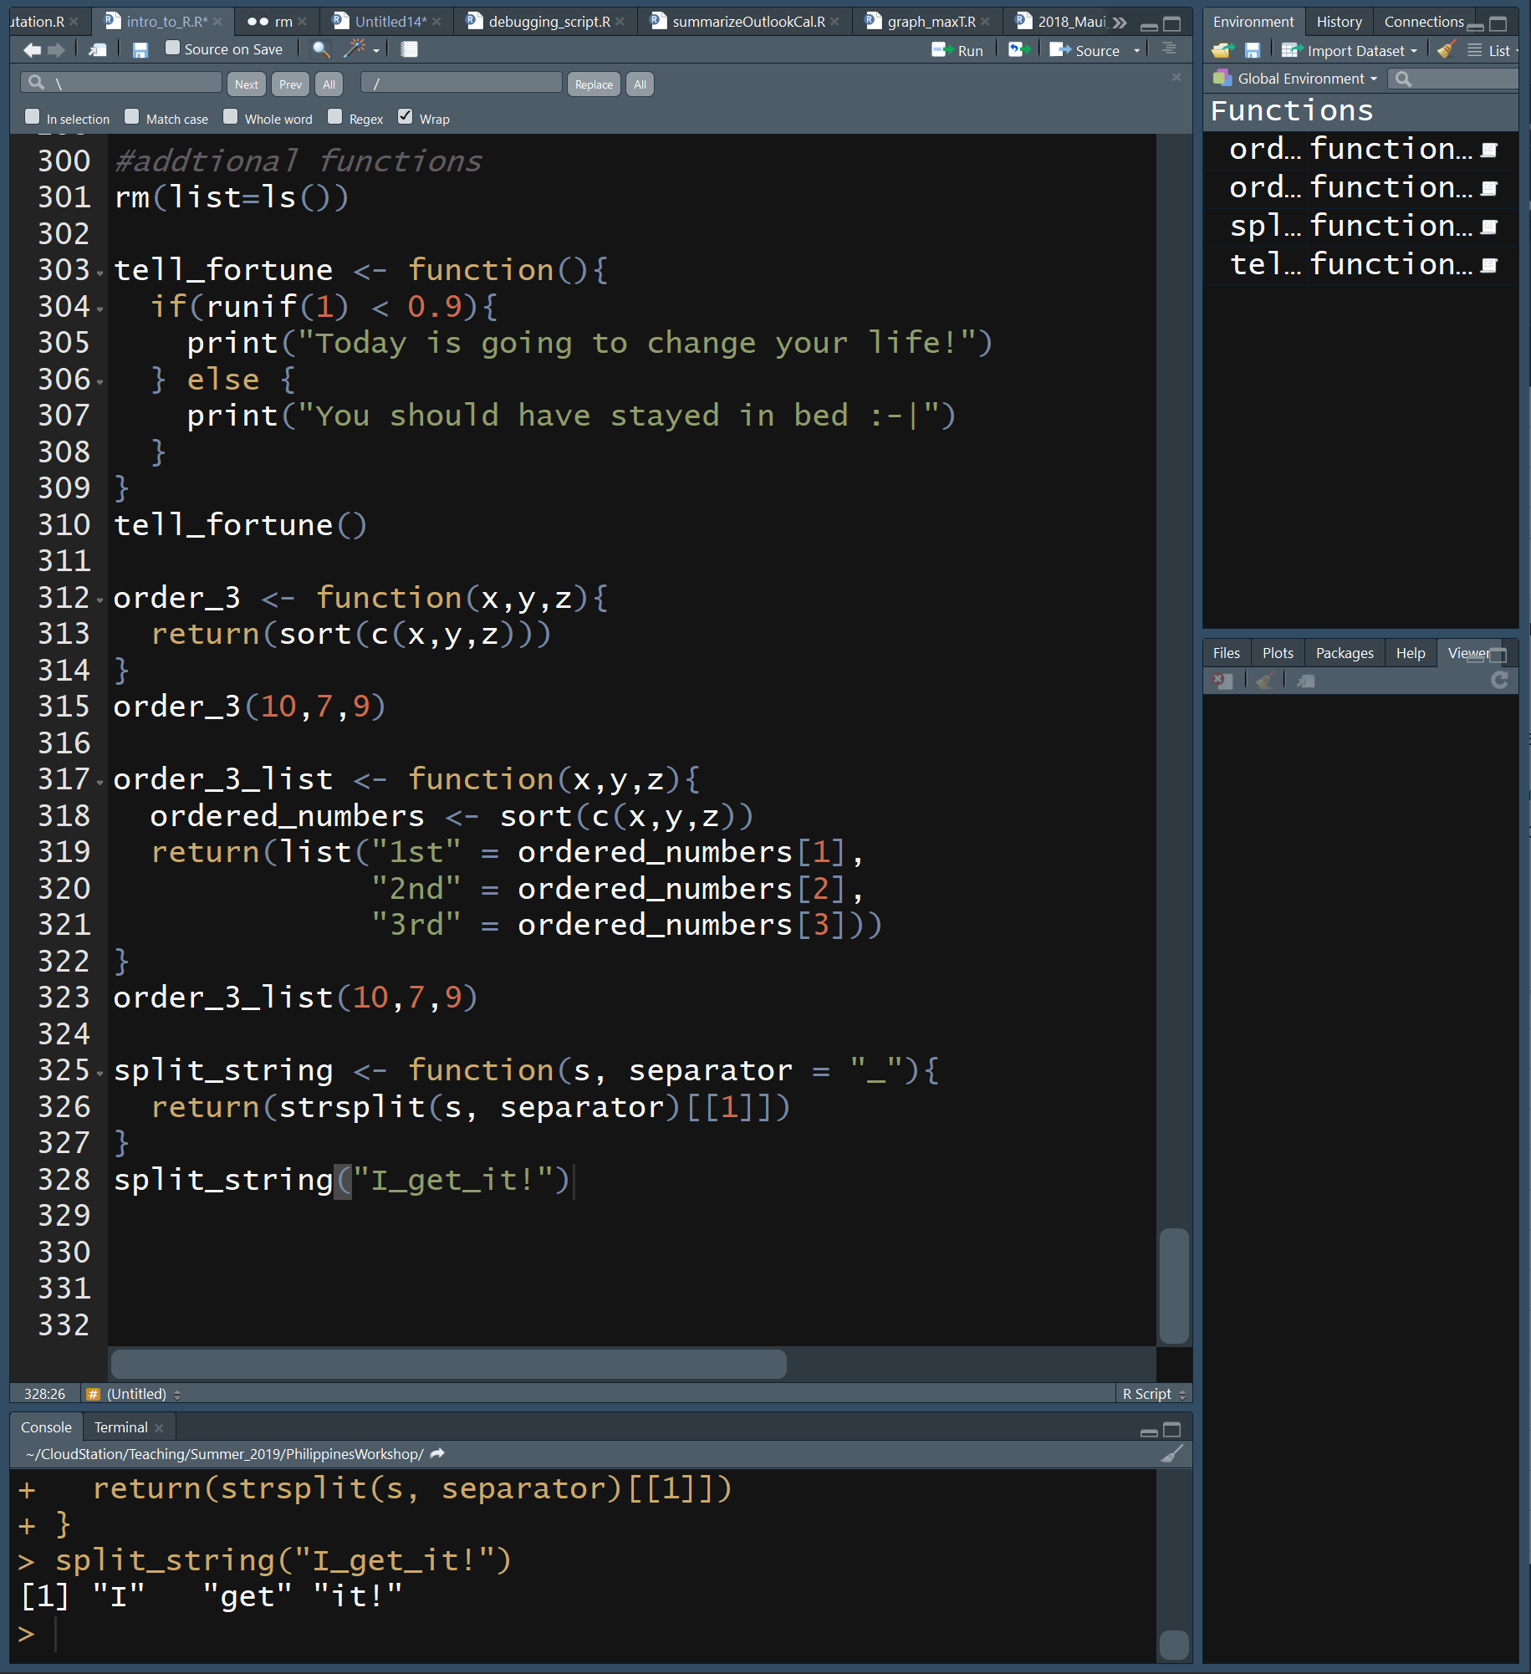
More R Functions
Can have no arguments
myFunc <- function(){commands}
Can have multiple arguments. Variables outside of the function must be read into the function
myFunc <- function(a,b,c){commands}
Can have default arguments. When run, a will be 2 unless another value is specified
myFunc <- function(a=2){commands}
Does not have to return values
Variables outside of the function are only available by passing them into the function, and vice versa

Slide 40
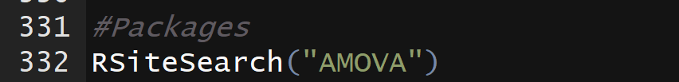
R Packages & Libraries
Does anybody know why a package name must be in quotes when installing it, but should not be in quotes when loading it with library()?
A package is a collection of R code, data, and functions that have been made publicly available
There are over 14,000 R packages
Packages must be installed
install.packages(“name_of_pkg”)
Once installed, packages must be loaded
library(name_of_pkg)
Where to find packages specialized for your research questions
https://cran.r-project.org/web/views/
https://github.com/
https://www.bioconductor.org/
Making packages
R Studio
http://r-pkgs.had.co.nz/

Slide 41
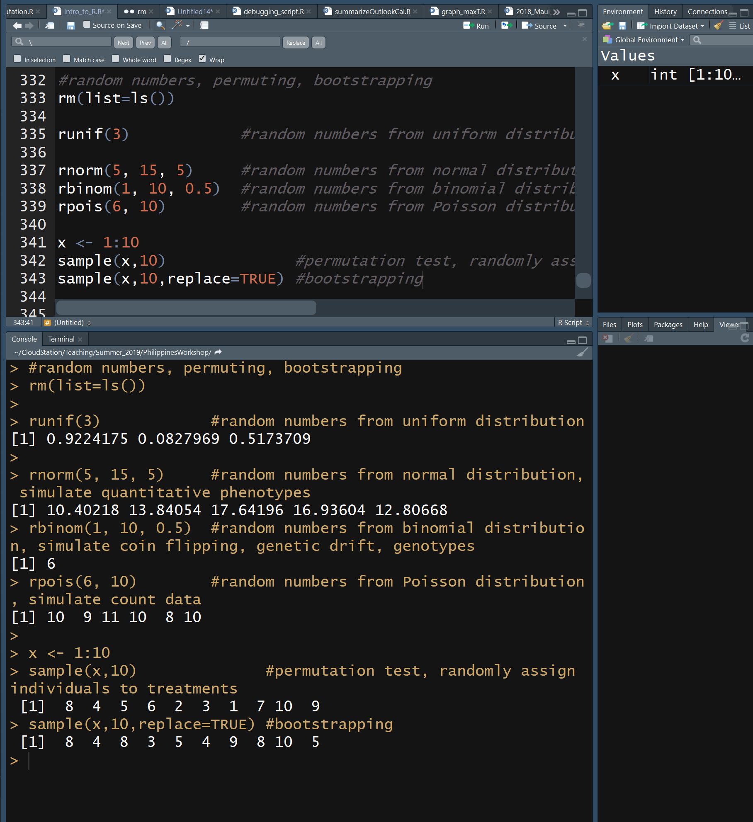
R Random Numbers
Random numbers are useful for simulations and customized tests for statistical significance
Random number from uniform dist
runif(number_of_random_nums)
Random number from normal distribution
rnorm(num_rands, mean=x, sd=y)
Random number from binomial dist
rbinom(num_rands, num_trials, probabilty)
Random number from Poisson distribution
rpois(num_rands, lambda=x)
Permute
sample(vector_or_list, num_samps)
Bootstrap
sample(vector_or_list, num_samps, replace = TRUE)

Slide 42
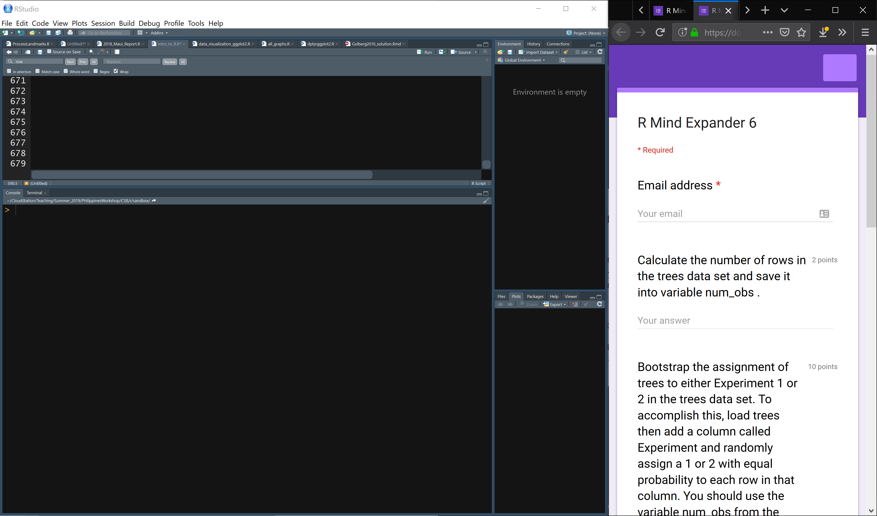
Link to Mind Expander 6 through github
Work independently or in groups to answer the questions

Slide 43
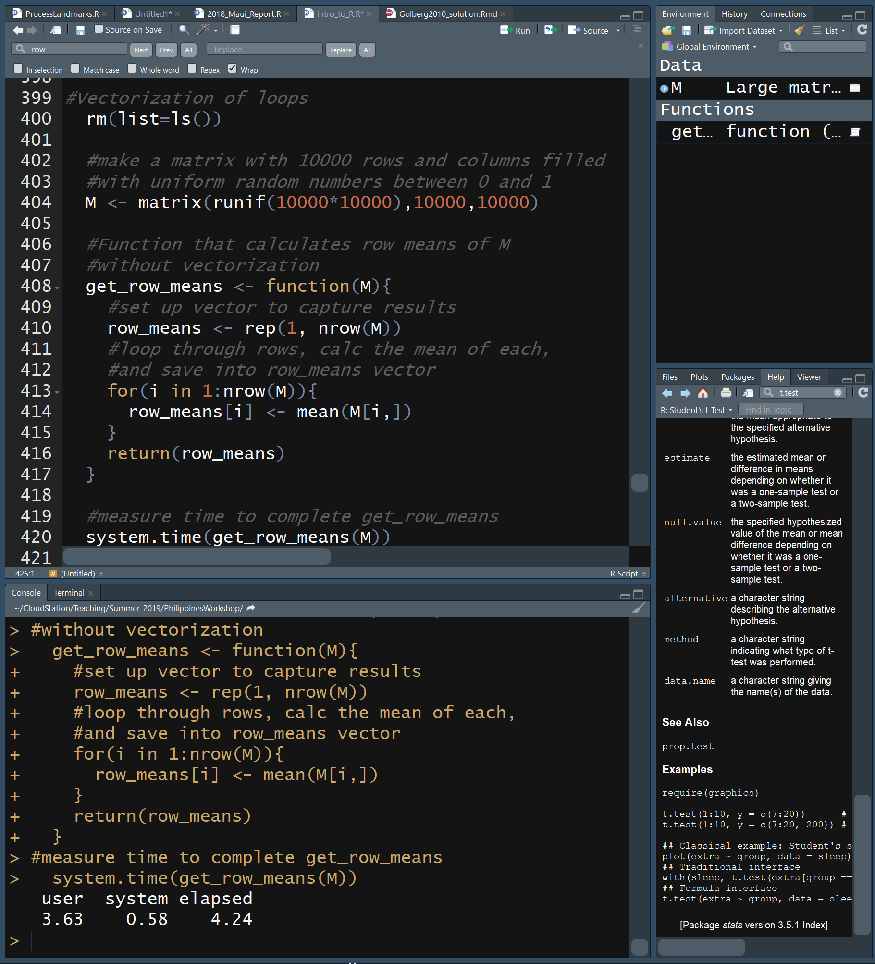
R Loops are Slow
For and while loops in R are easy to use but are very slow
This is because R runs commands 1 by 1 and does not know what’s coming next
In faster languages, like C, code is compiled and all commands are known before running, allowing for optimization
Here we use a for loop to calculate the mean of each row in a very large matrix filled with random numbers and record the length of time to complete the task

Slide 44
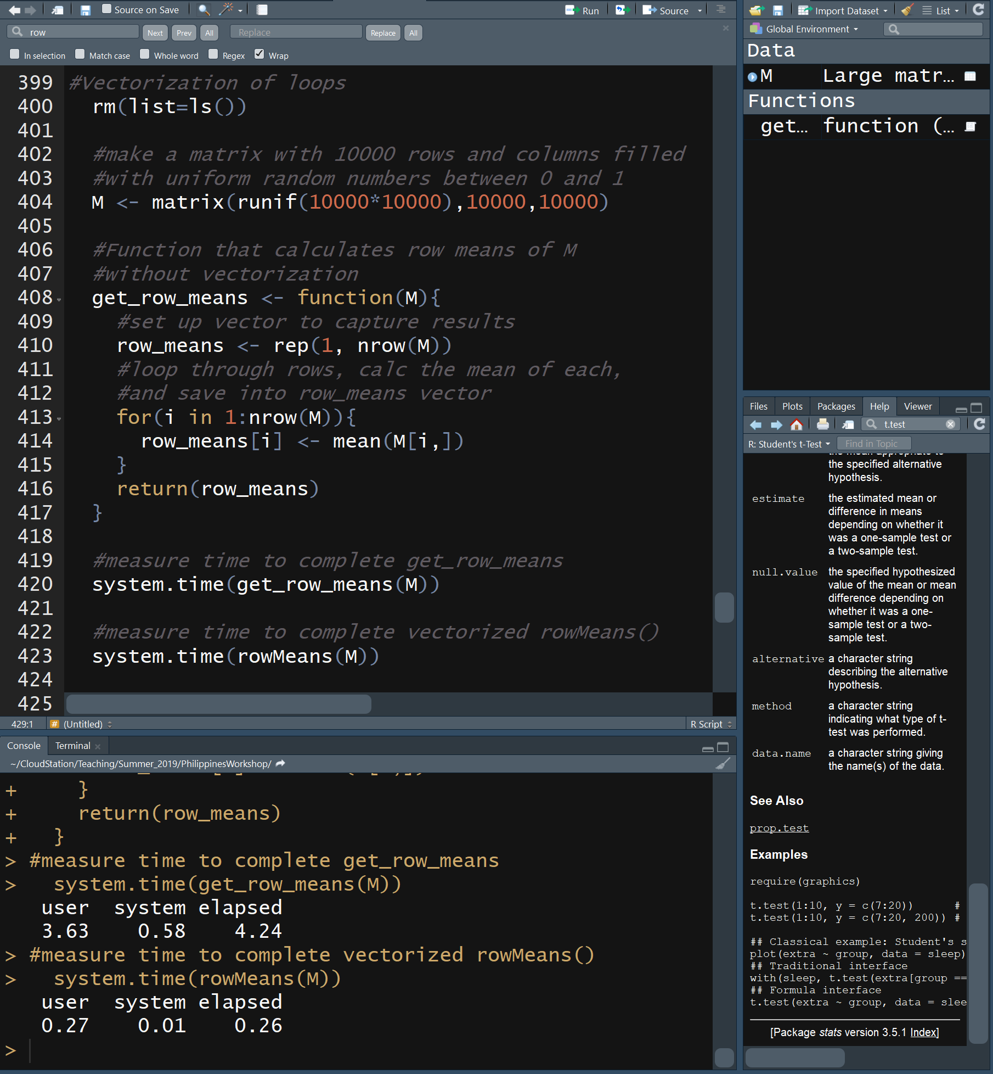
R Vectorization of Loops
Vectorized functions can run loops much faster
R only has to figure out the flow for 1 element in the vector and the code runs much faster
The function rowMeans() is vectorized
Now we vectorize the calculation of row means and measure how long it takes to complete the task

Slide 45
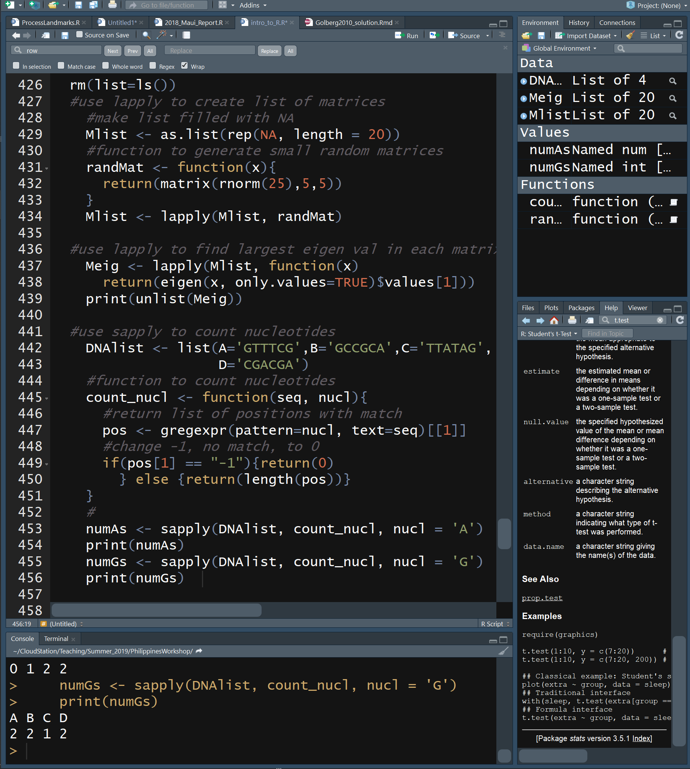
R Vectorization of Loops
lapply(list_of_values, function)
applies a function to each element in list and returns a list of results
unlist(list_of_vals) changes list into vector
sapply(list_of_values, function)
Just like lapply, but returns a vector
In example, the user-defined function (count_nucl) accepts 2 arguments (seq, nucl). The list (DNAlist) populates seq, the second argument is explicitly specified in the sapply statement: , nucl = ‘A’

Slide 46
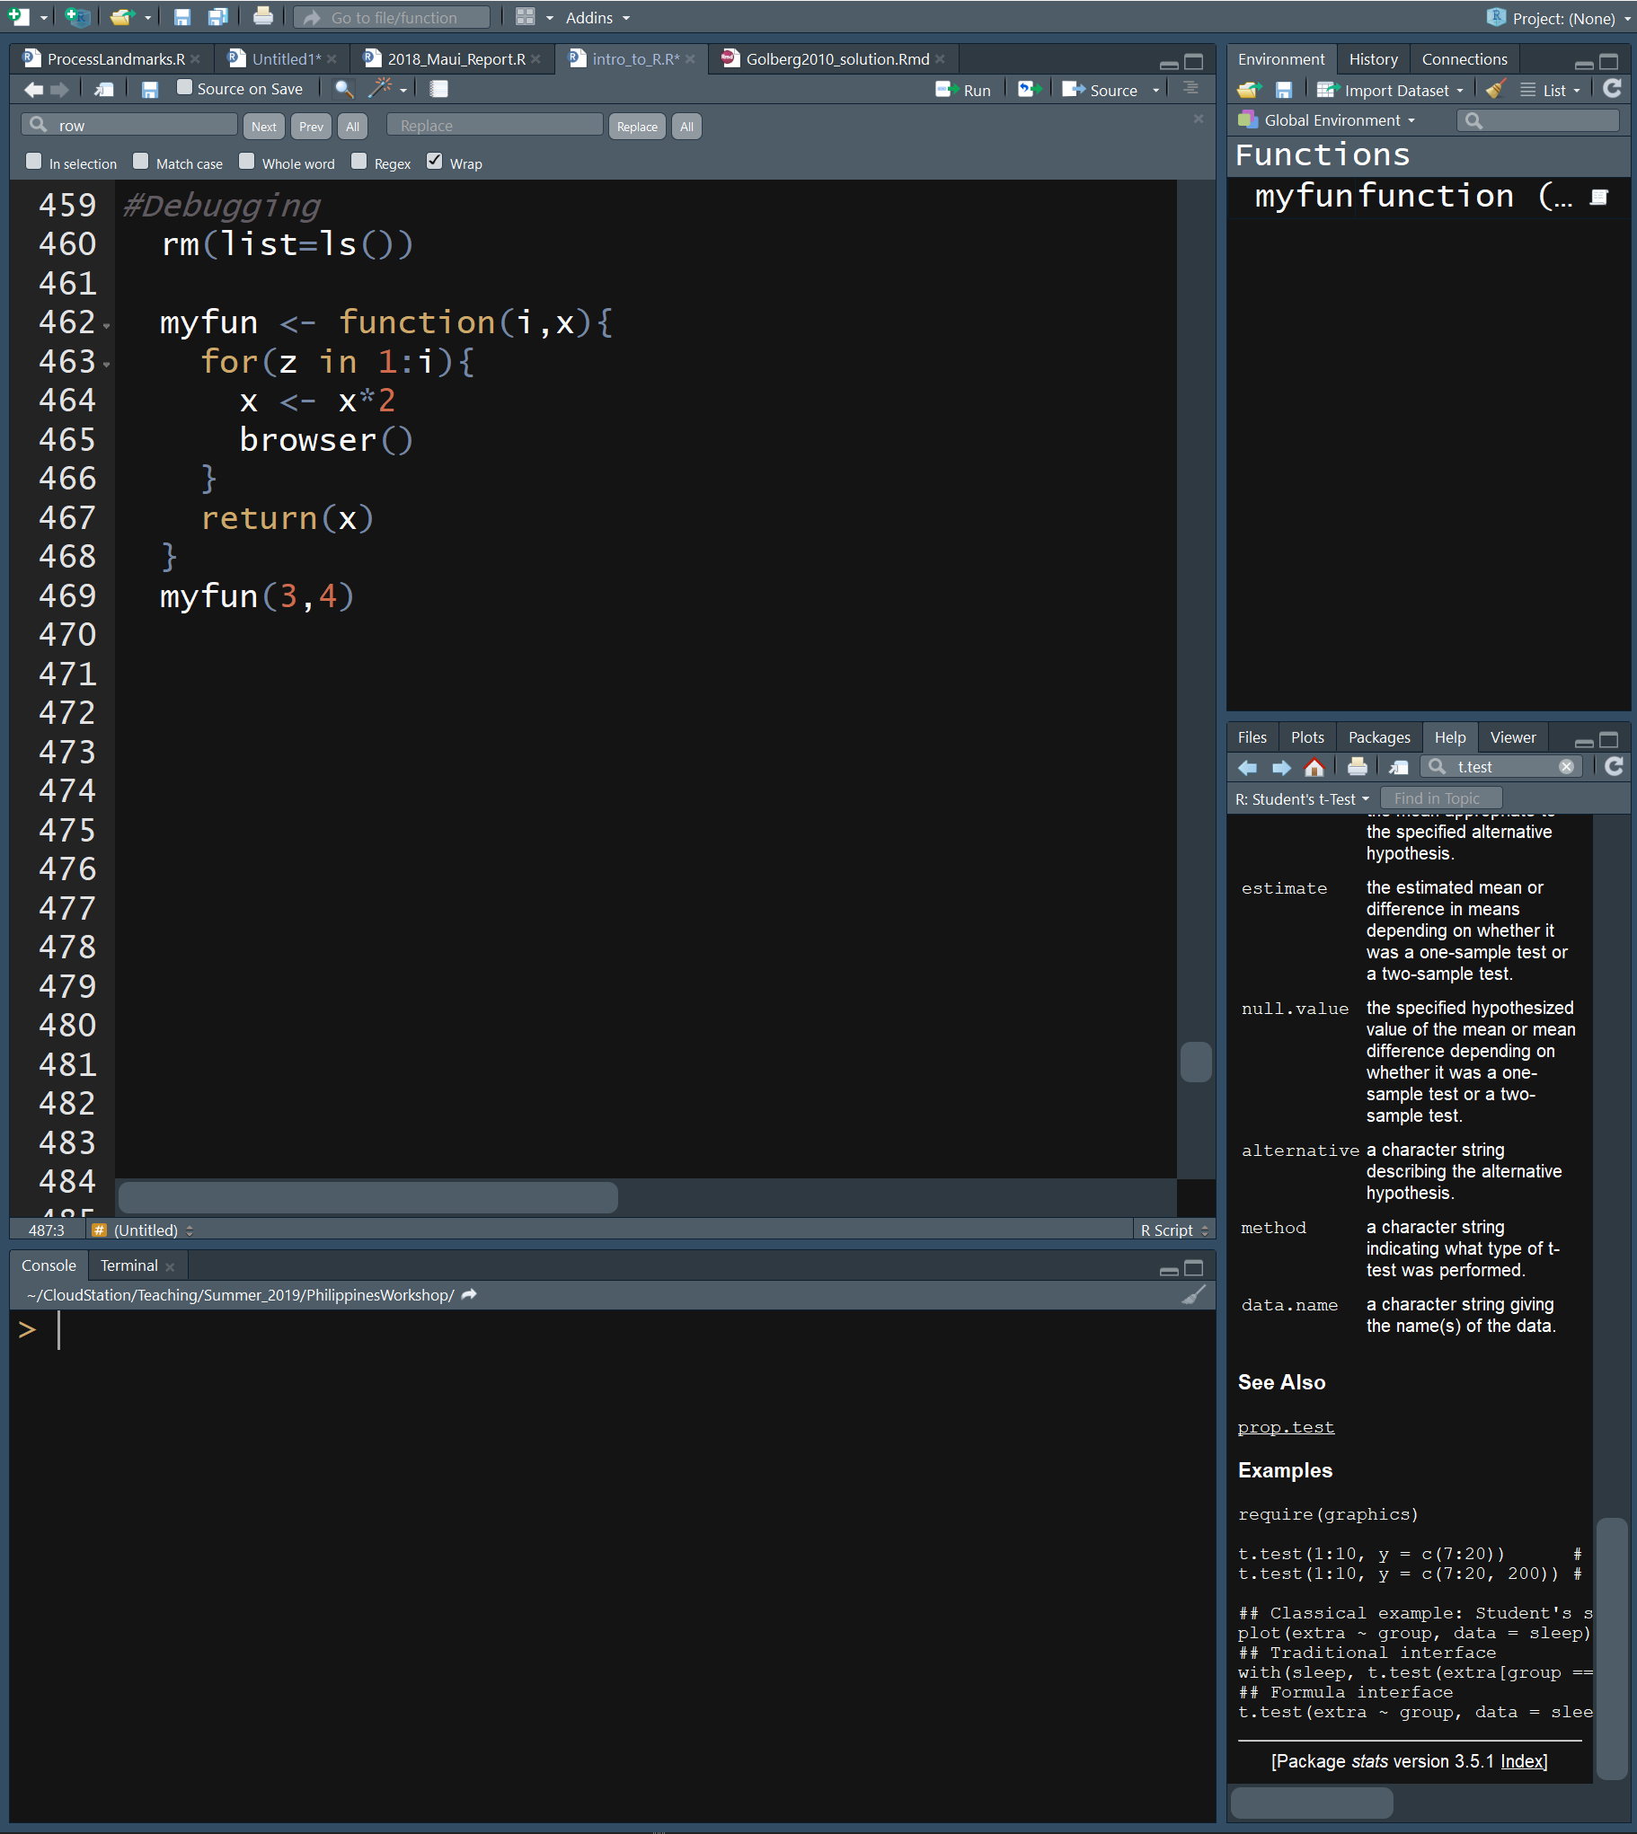
R Debugging
Errors in the code (bugs) are common
Some errors elicit warning messages or cause code to stop
Silent errors can be hard to detect, thus it is important to test your code
Use test data with known answer
Check values in data structures
You can pause your code using browser()

Slide 47
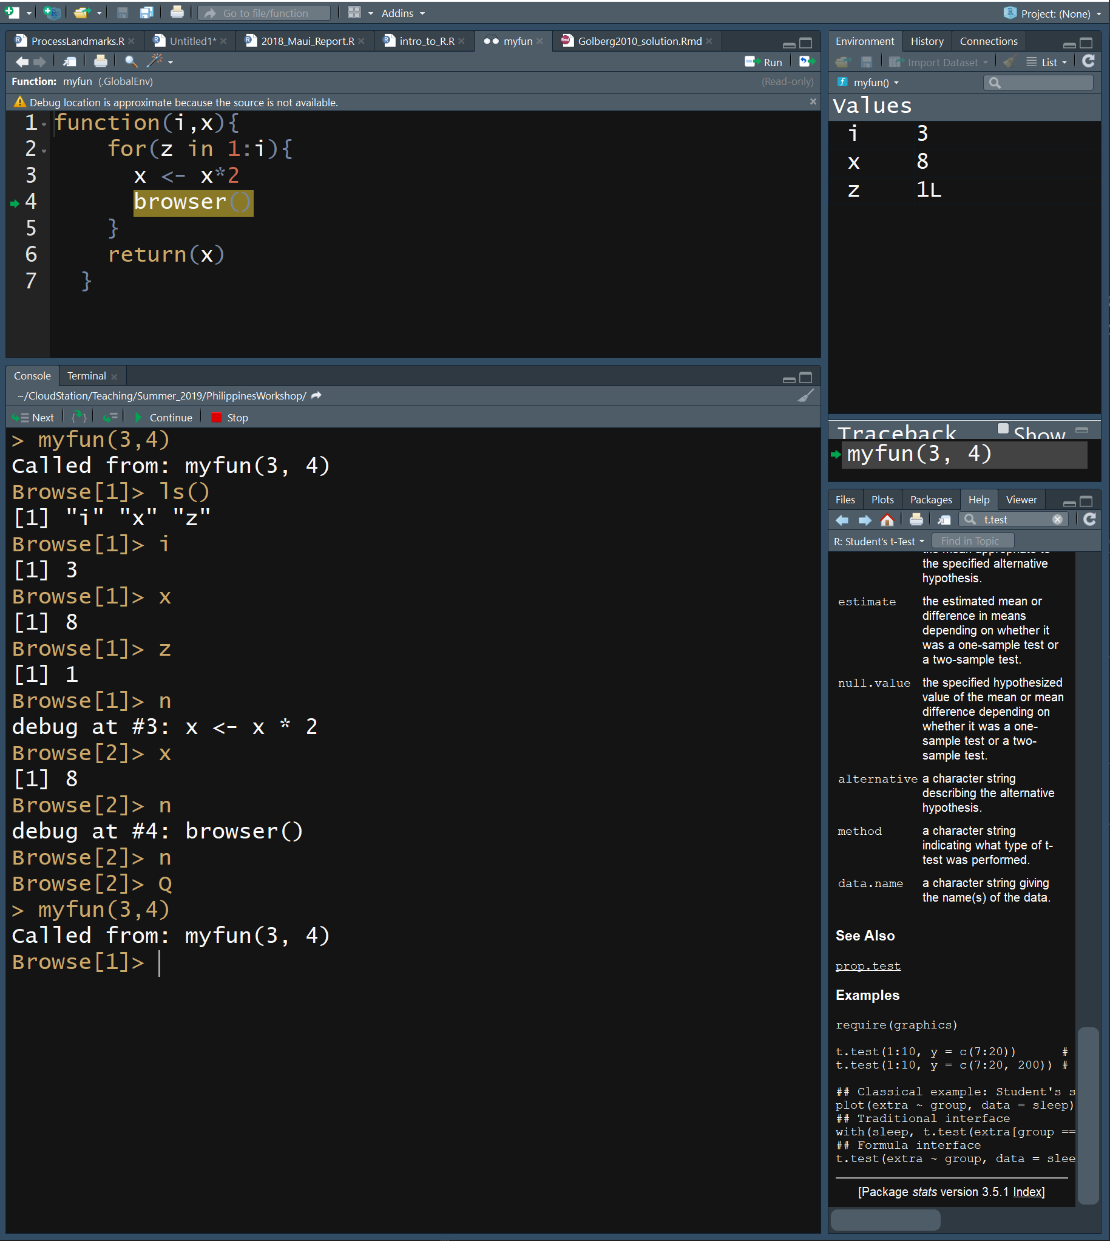
R Debugging
When you run the code, you enter debugging mode at browser()
View local variables with ls()
Check values of variables
Press n to execute next statement
Check value of x again
Press Q to exit browser and function
Press c to continue function and exit browser

Slide 48
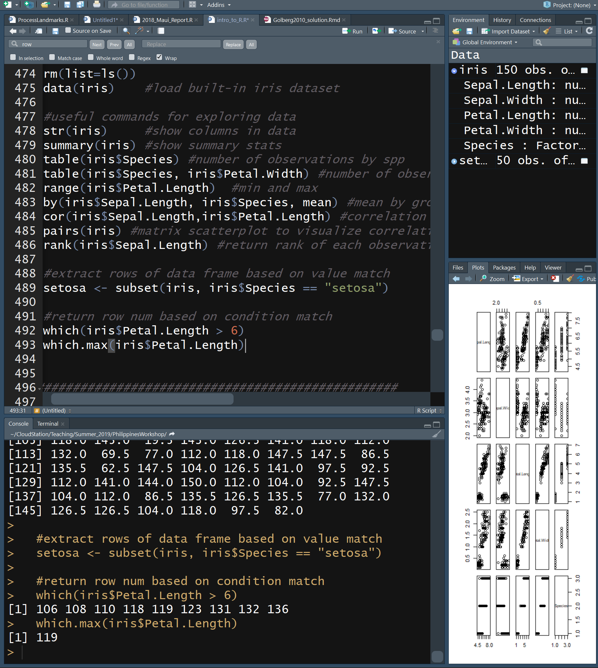
R Statistics
R is a stats language and has many statistical functions built-in

Slide 49
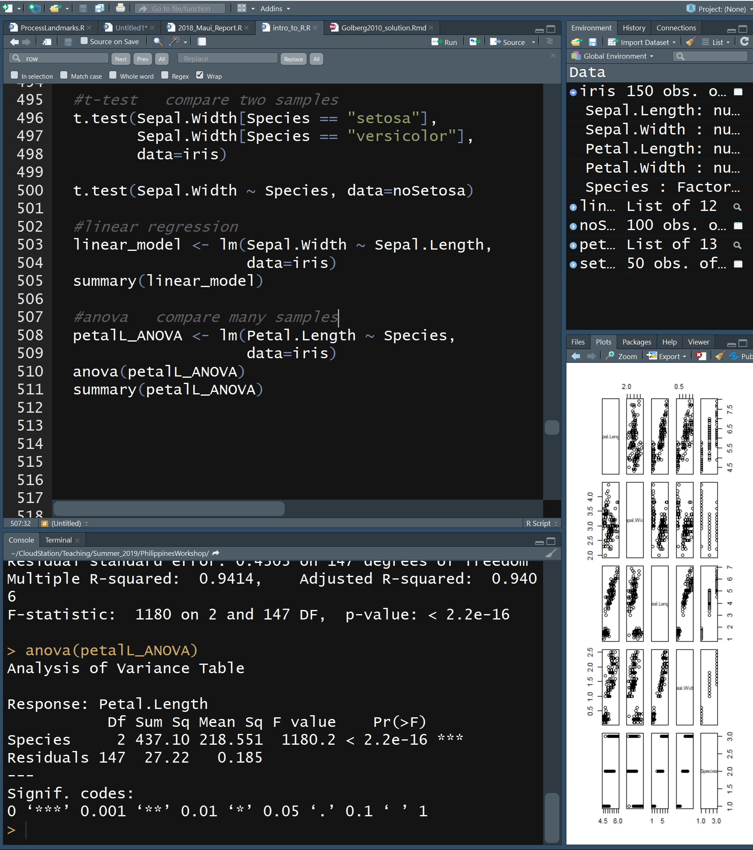
R Statistics
R is a stats language and has many statistical functions built-in
t-test: compare two samples
t.test(vector1, vector2)
t.test(dataVector ~ groupVector)
Linear regression
lm(responseVector ~ predictorVector)
ANOVA
lm(responseVector ~ predictorVector)
anova()

Slide 50
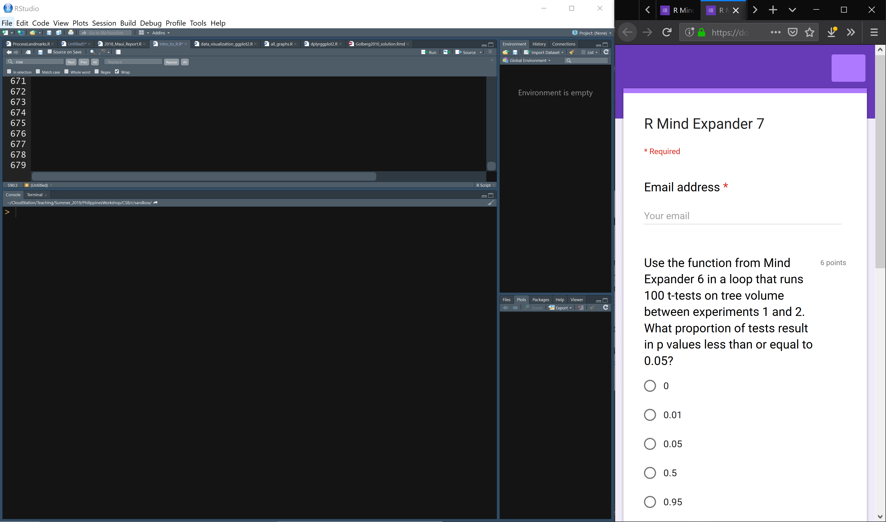

Link to Mind Expander 7 through github
Work independently or in groups to answer the questions

Slide 51
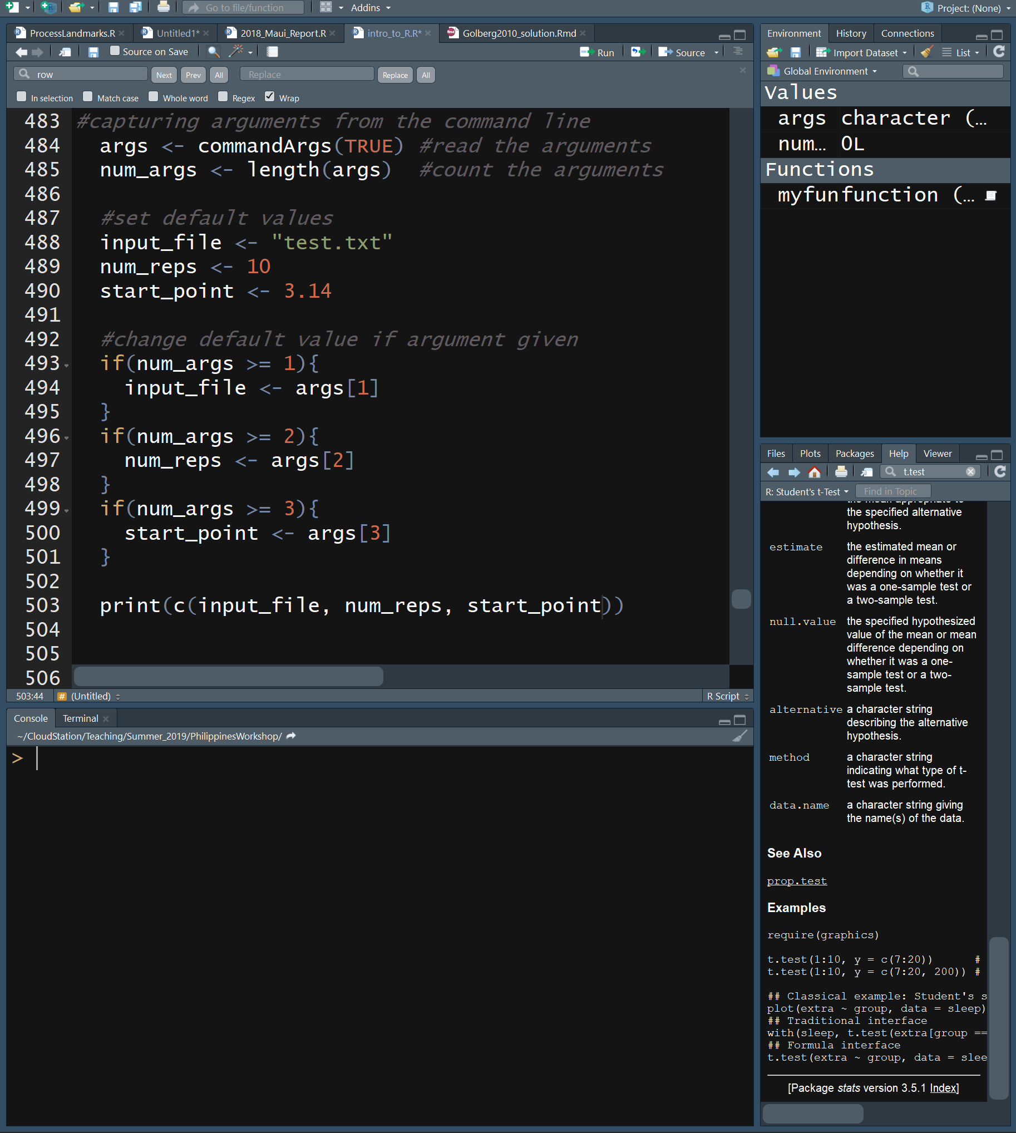
Running R from Linux Command Line
You may want to run your r script on a super computer or use it in a bash script
Rscript my_script.R
You can pass arguments from bash into R
Rscript my_script.R arg1 arg2
In your rscript you must pass the arguments into a variable
args <- commandArgs(TRUE)
It is a best practice to define default values and order the arguments so the optional follow the required
Print the variable values to document what settings were used

Slide 52
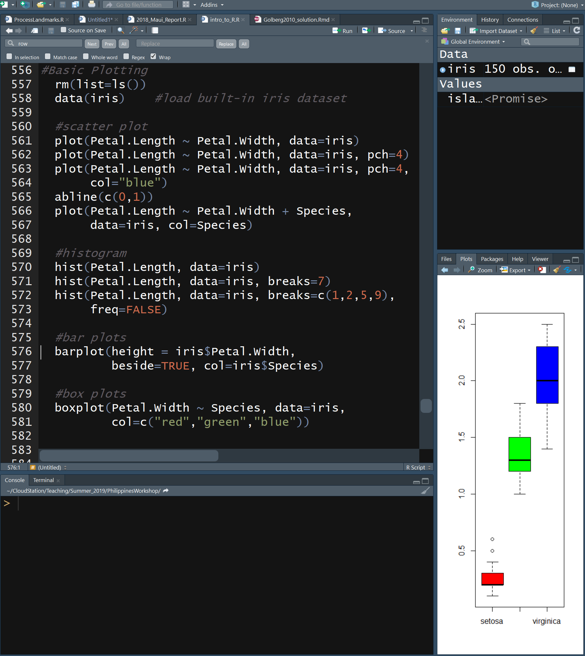
R Basic Plotting
R also has built in commands for plotting results
Scatter Plots
plot(responseVctr ~ predictorVctr)
Draw line on plot
abline(c(y-intercept,slope))
Histograms
hist(vector)
Bar plots
barplot(vector)
Box plots
boxplot(responseVctr ~ predictorVctr)

